Slide 1



Model of Large Scale
Conformation Mobility in Proteins
Yaroslav Ryabov,
G Marius Clore, Charles D Schwieters

Slide 2
Outline
Conformational transitions on different time scales
Model of conformation transitions between discrete states
Closed form expression for correlation function
Time domain vs. Frequency domain
What to expect: Illustrative calculations

Slide 3
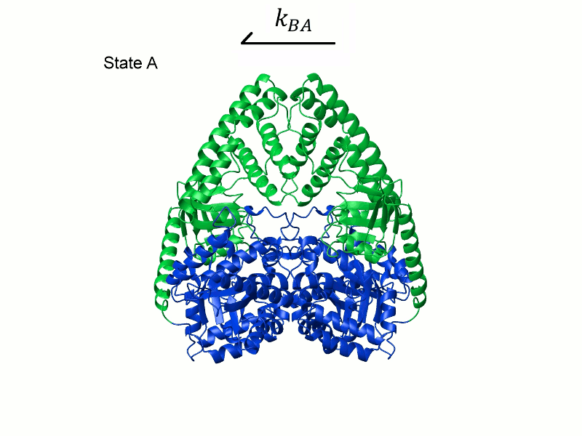
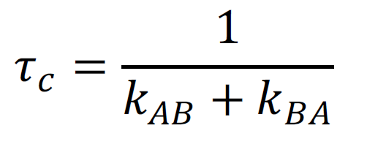
Time scale of Conformational transitions

Slide 4
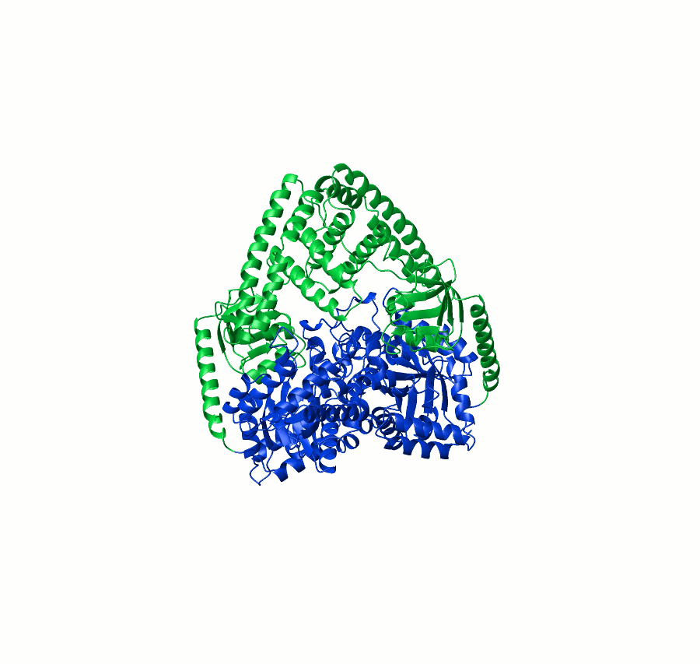
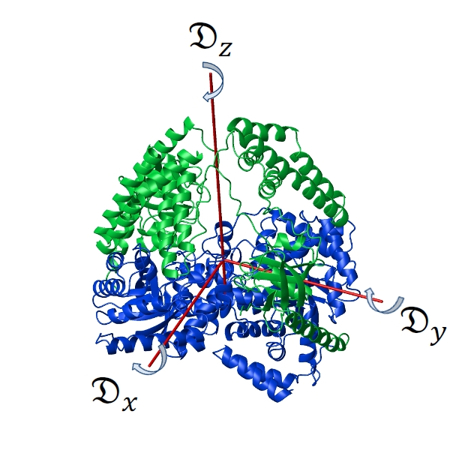
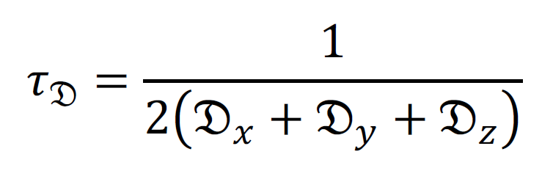
Time scale of Rotational diffusion

Slide 5
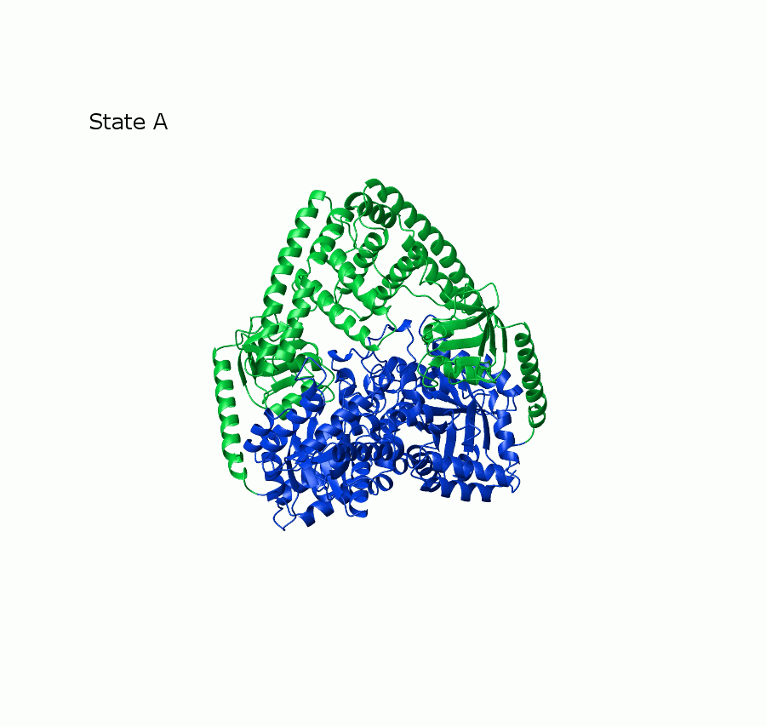
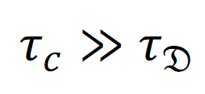


Conformation transitions on different time scales
Slow Exchange
Approximation of two species
with two different structures
and two diffusion tensors
and

Slide 6



Conformation transitions on different time scales
Fast Exchange
Approximation of single conformer
with one averaged structure
and one averaged diffusion tensor

Slide 7

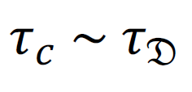
Conformation transitions on different time scales
Intermediate Exchange
?

Slide 8
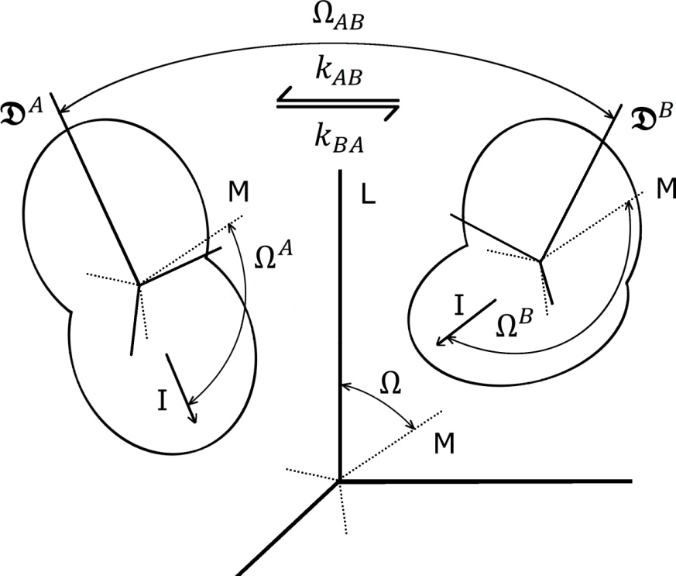


Rotational diffusion of semi-Rigid molecule
Conformation transition between
discrete set of states
Molecule tumbles in isotropic solvent
Molecule exchanges between discrete
conformations
In each conformation state molecule is rigid
and has diffusion tensor
The transition time is much shorter than the time
which molecule spends in any conformation
Berne, Pecora (1968); Wong, Case and Szabo (2009)

Slide 9
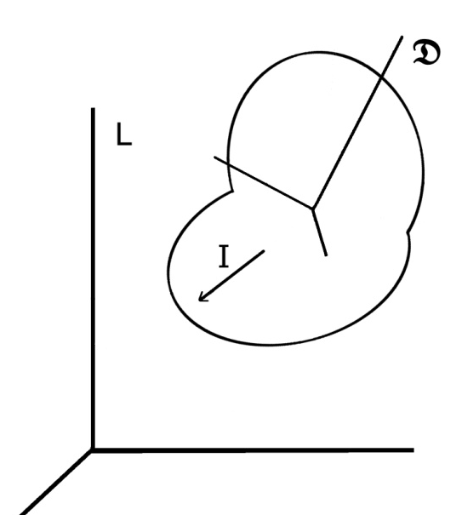
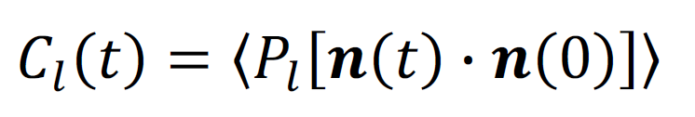

Relationships between experimental observables and theoretical calculations
Orientation correlation function
Spectral density
Fourier transform
Linear Combination
Experimental observables: R1, R2 etc.

Slide 10
Solution in time domain cannot be represented in closed forms
due to Abel impossibility theorem (1824)
Orientation correlation function
Poster # 396
Chopin Ballroom, Thursday 2:00 -3:45 pm
Ryabov, Clore, Schwieters, JCP 136 (2012) 034108

Slide 11
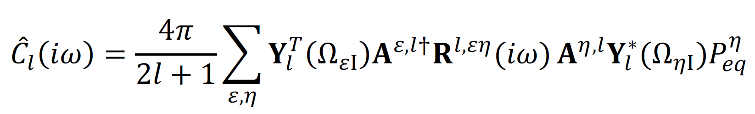
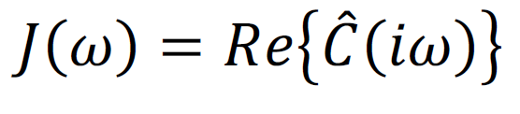
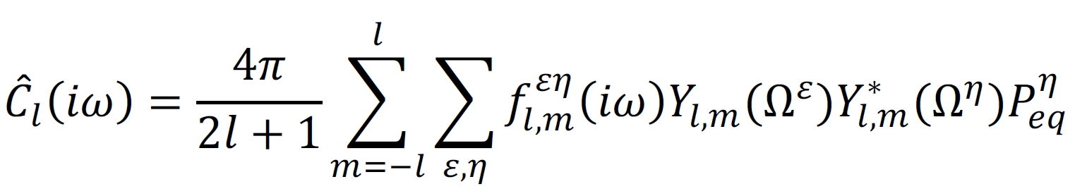
Rotational diffusion of semi-Rigid molecule
Correlation function in frequency domain
Ryabov, Clore, Schwieters (2012)
Spectral density
Berne, Pecora (1968); Wong, Case and Szabo (2009)

Slide 12











Illustrative calculations
Estimations of XplorNIH @ 300 K
EI dimer
Assumptions
Symmetric motions
Equal occupation

Slide 13
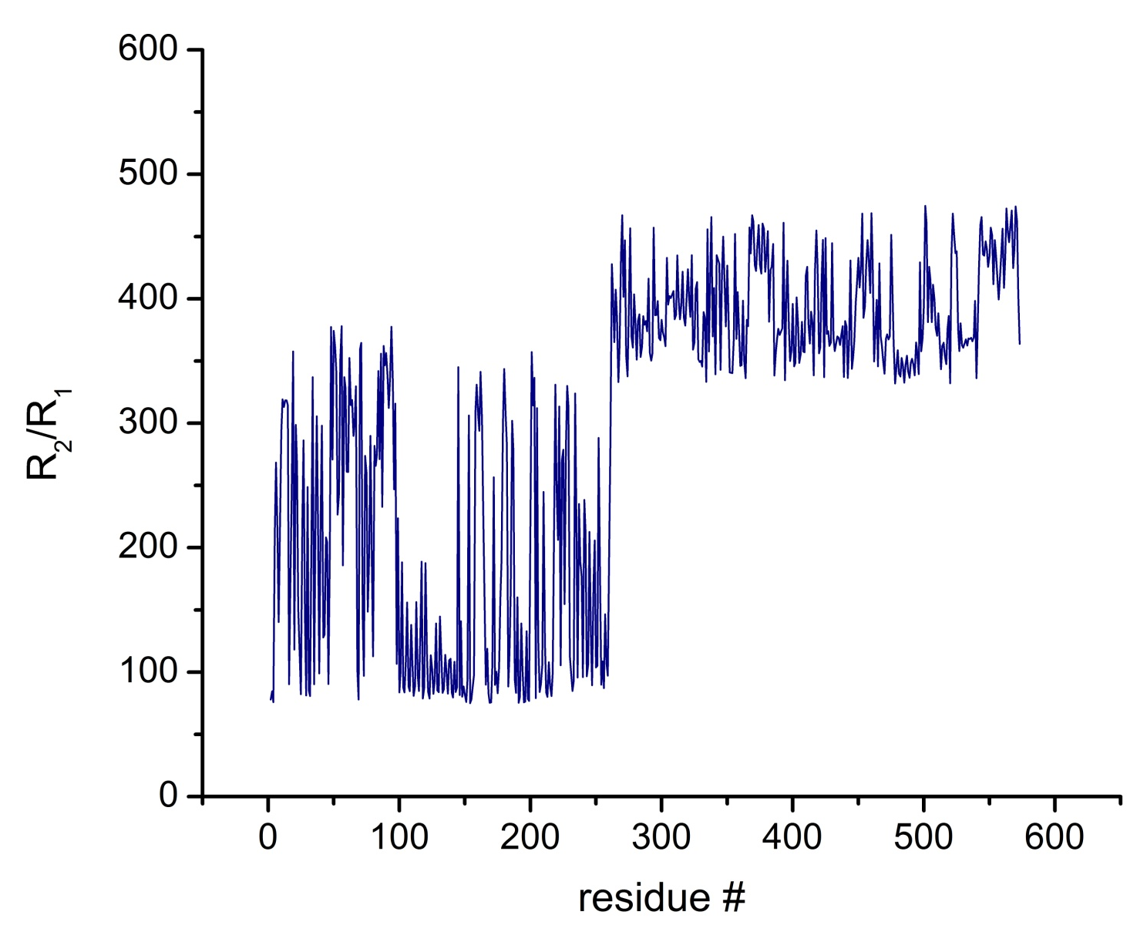
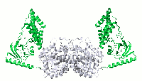
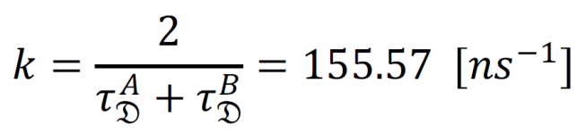
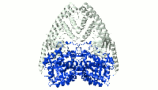
Illustrative calculations
NMR relaxation rates for 600 MHz @ 300 K
N- terminus
C- terminus

Slide 14
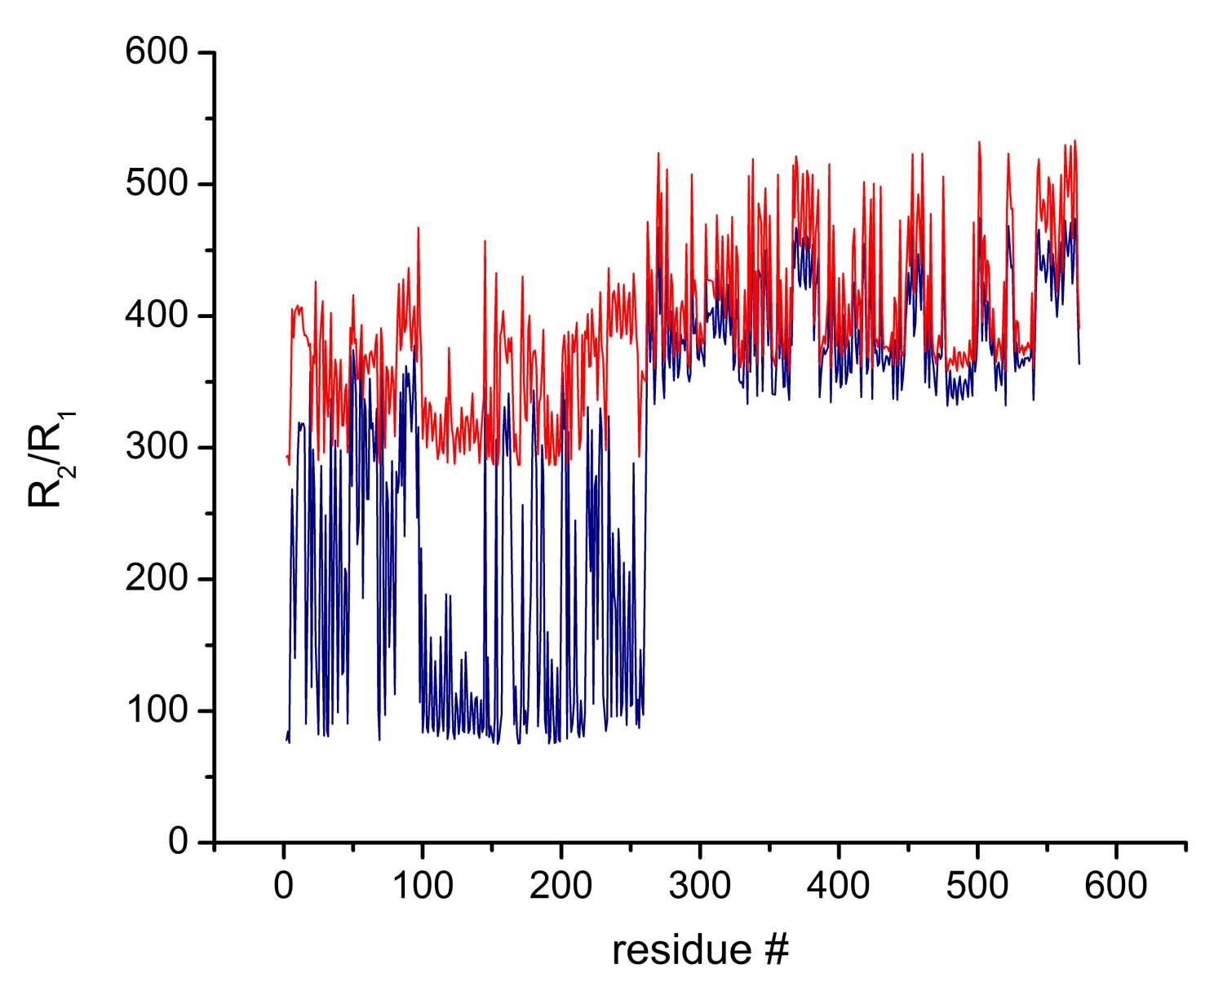
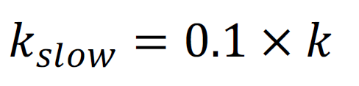
Illustrative calculations
NMR relaxation rates for 600 MHz @ 300 K

Slide 15
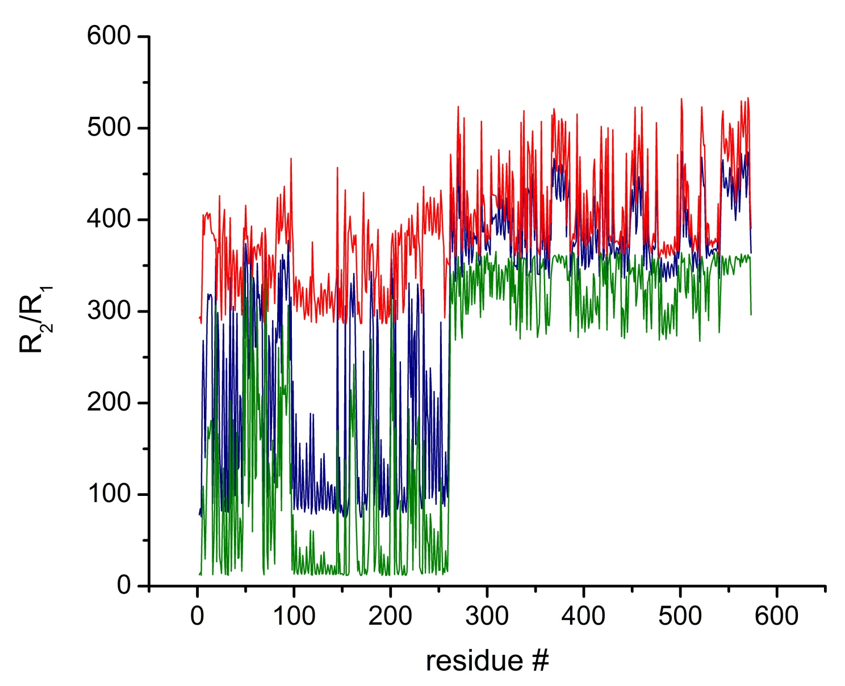
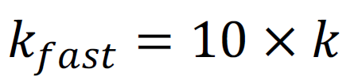
Illustrative calculations
NMR relaxation rates for 600 MHz @ 300 K

Slide 16
Concluding notes
Our Model
Provides closed form solutions in frequency domain ready for evaluation of spectral density etc.
Provides known limiting cases and is reproduced by Monte Carlo simulations
Not universal: discusses only the transitions between discrete states
However, accounts for arbitrary symmetry of diffusion tensors, arbitrary reorientation of molecules upon conformation transition, and coupling between diffusion tumbling and conformation exchange

Slide 17
Acknowledgments
Co-Authors
Charles D. Schwieters
G. Marius Clore
Extremely Useful Discussions
Alexander Berezhkovskii
Attila Szabo

