Slide 1



Model of Large Scale
Conformational Mobility in Proteins
Yaroslav Ryabov

Slide 2
Outline
Conformational transitions on different time scales
Equation of rotational diffusion
Eigenfunctions of free diffusion Liouville operator
Conformational transitions and associated system of linear differential equations
Eigen and non-Eigen decompositions
Abel’s impossibility and the way we trick it: Time domain vs. Frequency domain.
What to expect: Illustrative calculations

Slide 3
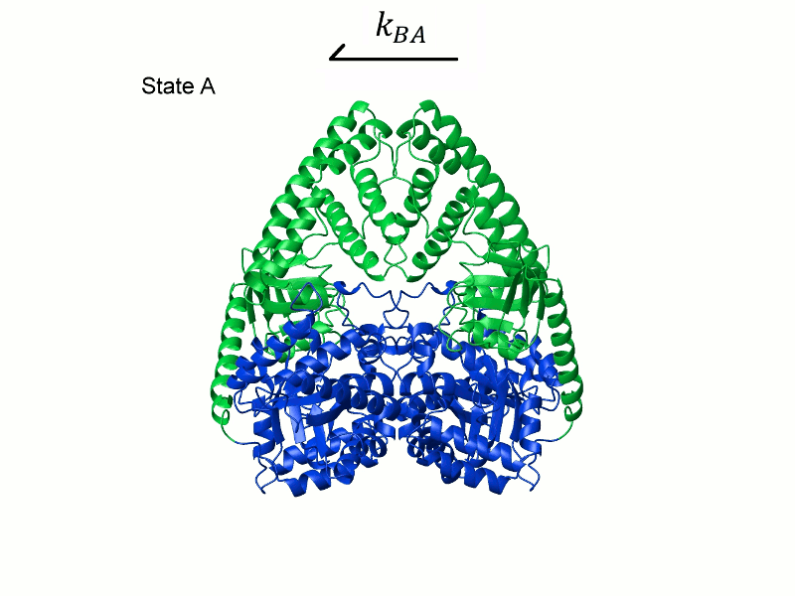
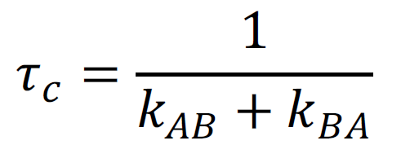
Time scale of Conformational transitions

Slide 4
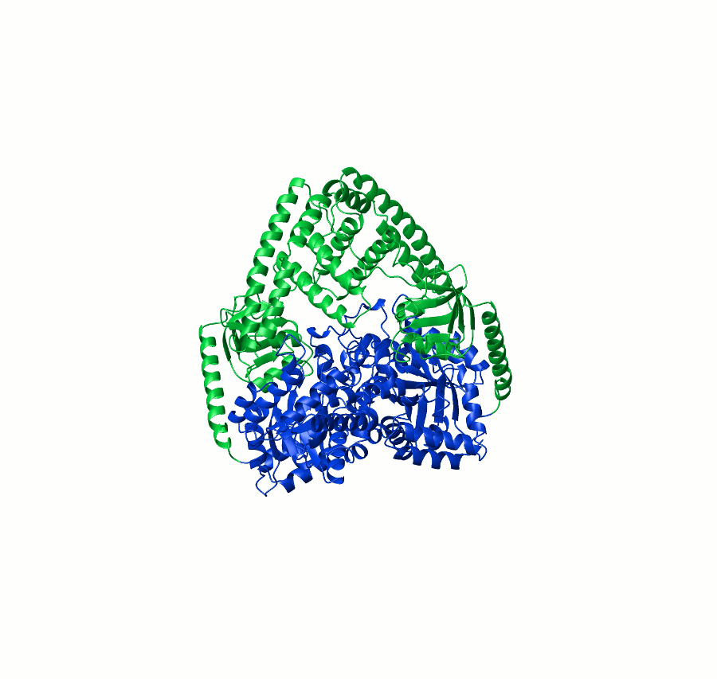
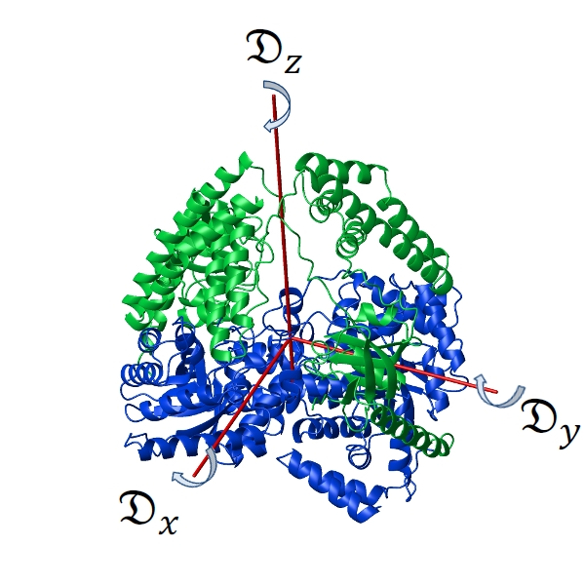
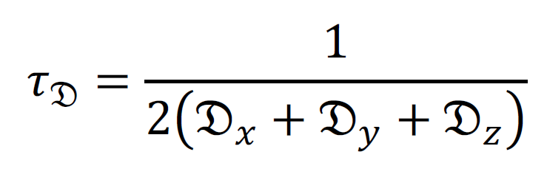
Time scale of Rotational diffusion

Slide 5
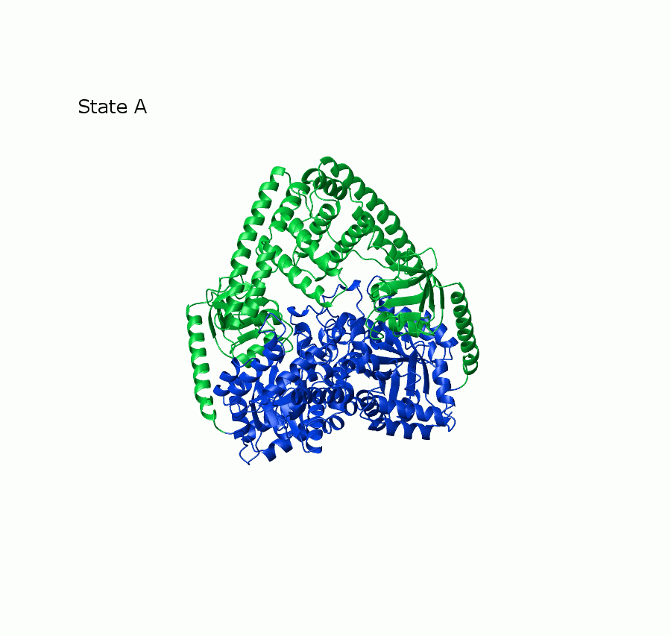
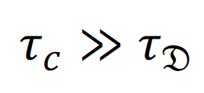


Conformation transitions on different time scales
Slow Exchange
Approximation of two species
with two different structures
and two diffusion tensors
and

Slide 6



Conformation transitions on different time scales
Fast Exchange
Approximation of single conformer
with one averaged structure
and one averaged diffusion tensor

Slide 7

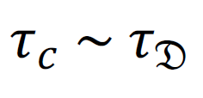
Conformation transitions on different time scales
Intermediate Exchange
?

Slide 8
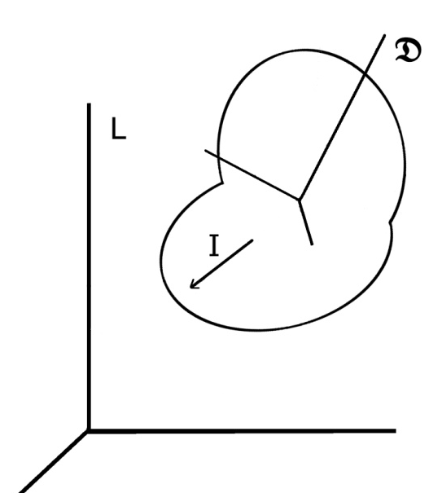
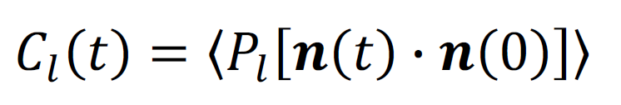

Rotational diffusion of Rigid molecule
Orientation correlation function
Spectral density
Fourier transform
Linear Combination
Experimental observables: R1, R2 etc.

Slide 9
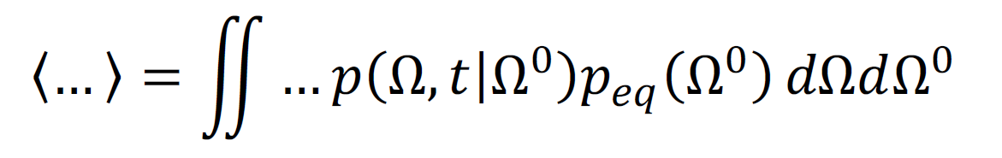
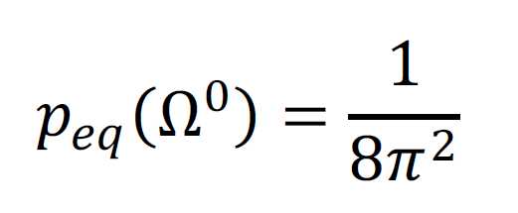
Rotational diffusion of Rigid molecule
Orientation correlation function
Spectral density
Statistic averaging
Isotropic environment

Slide 10
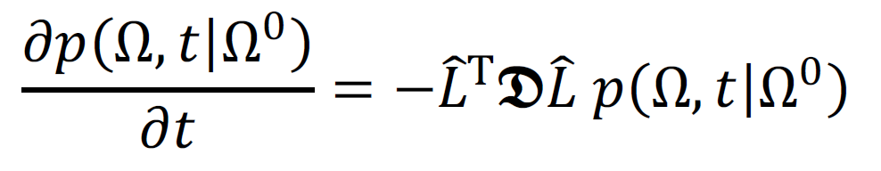
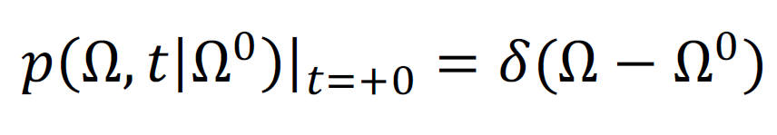
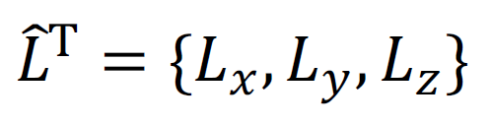
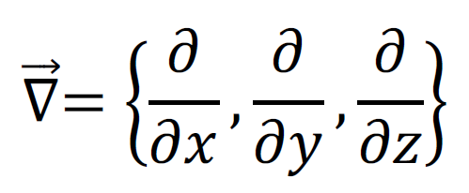
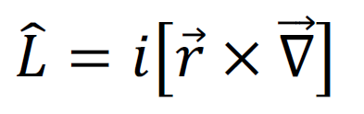
Rotational diffusion of Rigid molecule
Equation for Green’s function
Initial conditions
Operator of spatial rotations
F. Perrin (1934, 1936); L.D. Favro (1960)

Slide 11


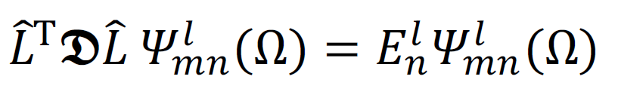
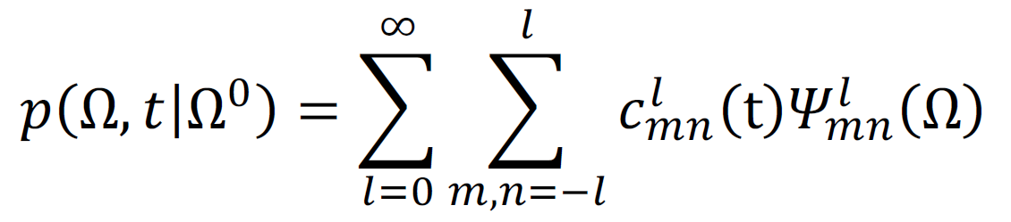
Rotational diffusion of Rigid molecule
Equation for Green’s function
Eigen functions of operator
Ansatz Solution
L.D. Favro (1960)

Slide 12
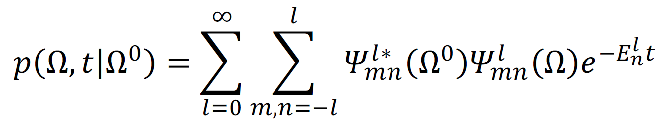
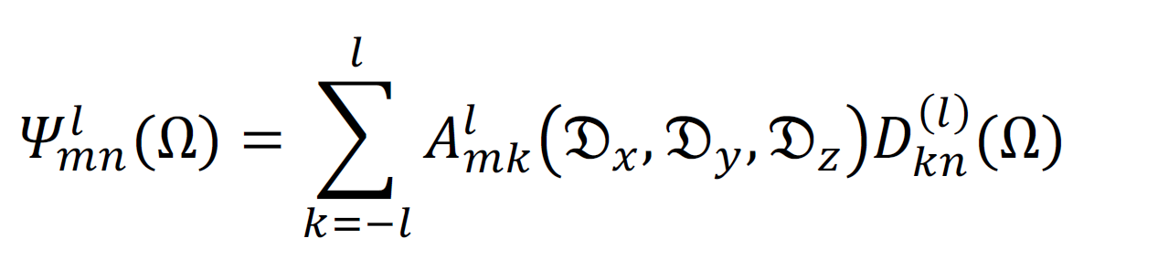
Rotational diffusion of Rigid molecule
Equation for Green’s function
Eigen functions of operator
Solution
Wigner rotation
matrix
L.D. Favro (1960)

Slide 13
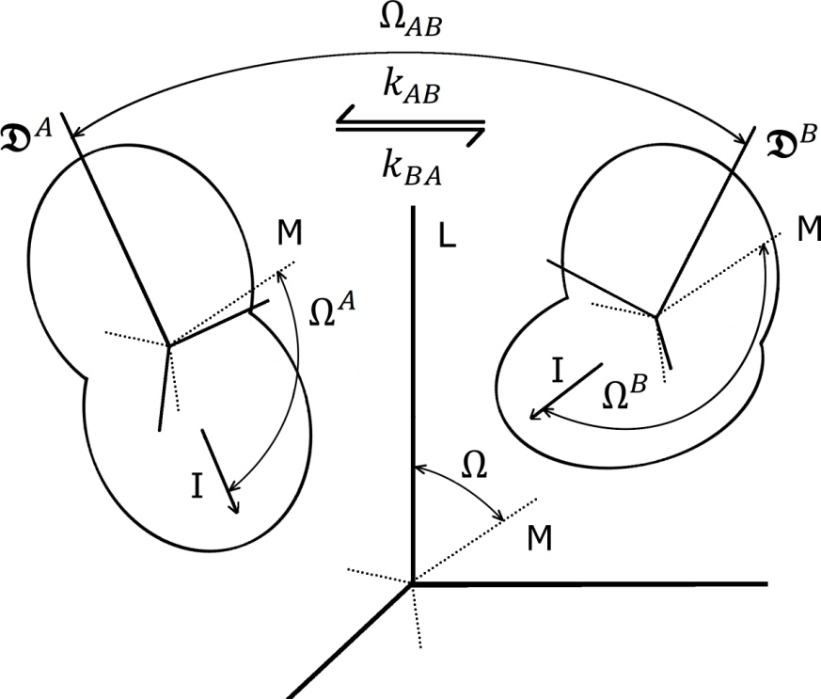


Rotational diffusion of semi-Rigid molecule
Conformation transition between
discrete set of states
Molecule tumbles in isotropic solvent
Molecule exchanges between discrete conformations
In each conformation state molecule is rigid and have diffusion tensor
The transition time is much shorter than the time
which molecule spends in any conformation
Berne, Pecora (1968); Wong, Case and Szabo (2009)

Slide 14
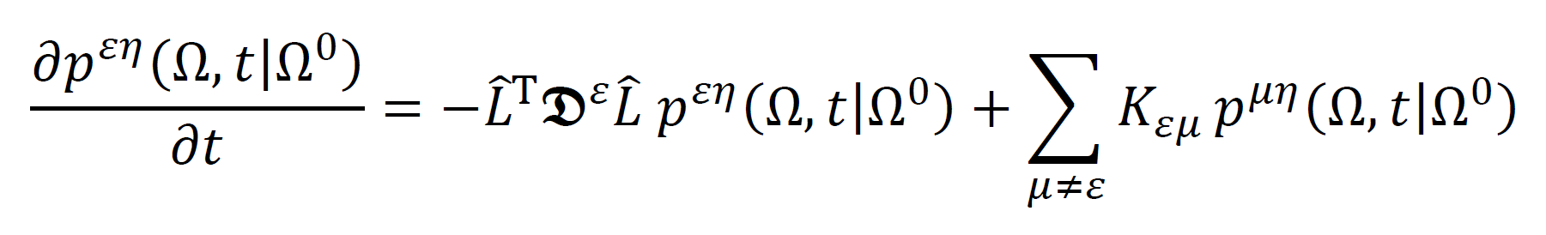
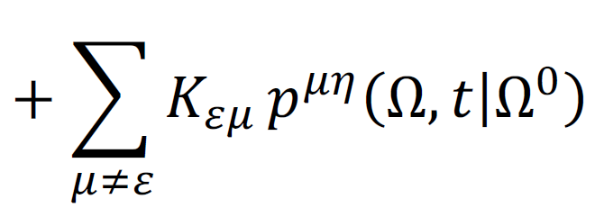
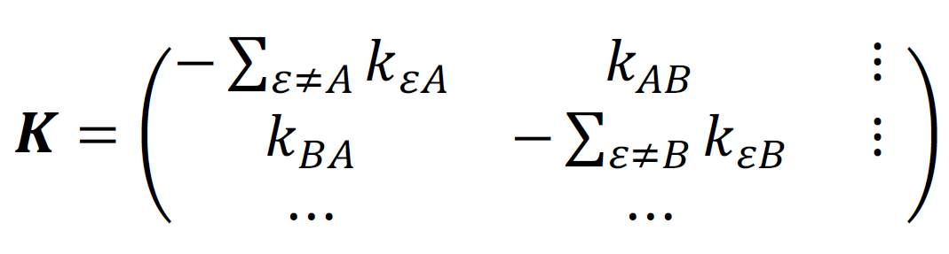
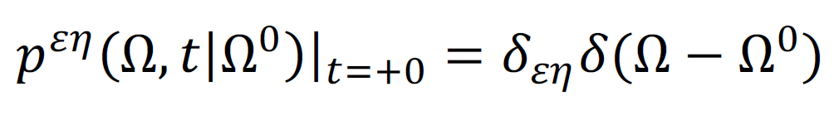
Rotational diffusion of semi-Rigid molecule
Equations for Green’s functions
Conformation exchange
Initial conditions
Berne, Pecora (1968); Wong, Case and Szabo (2009)

Slide 15
Rotational diffusion of semi-Rigid molecule
Equations for Green’s functions
Eigenfunctions are not available
in radicals
in closed forms

Slide 16
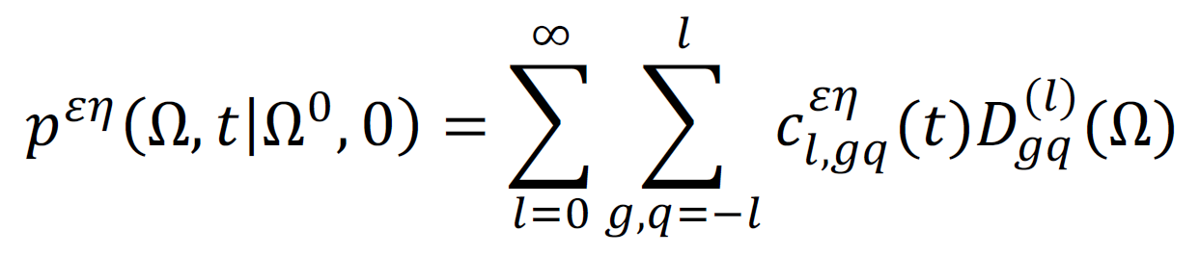
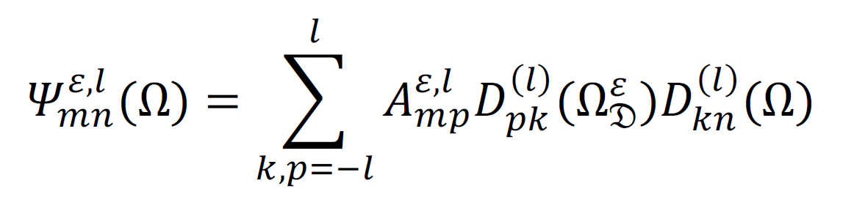
Rotational diffusion of semi-Rigid molecule
Equations for Green’s functions
Ansatz of non-eigen decomposition
Wigner rotation
matrix

Slide 17
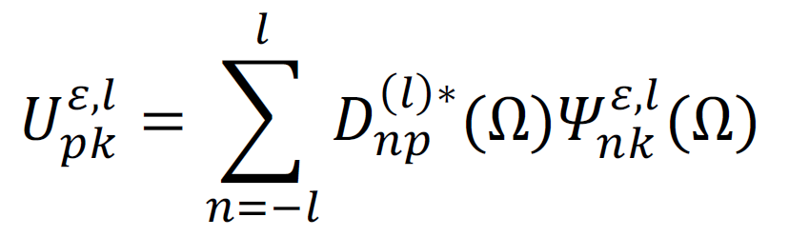

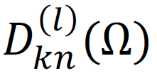
Rotational diffusion of semi-Rigid molecule
Equations for Green’s functions
Ansatz of non-eigen decomposition
Unitary transformation between
sets of
and

Slide 18
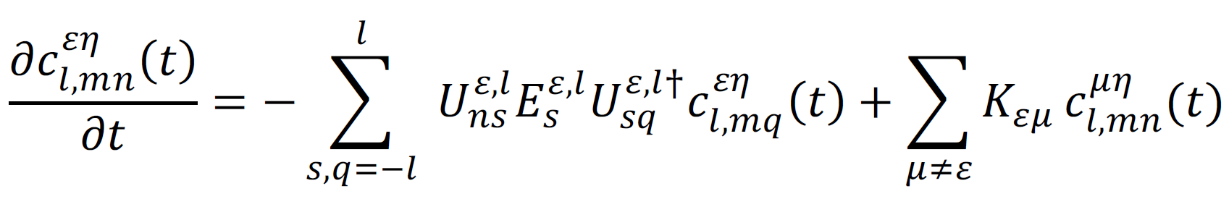
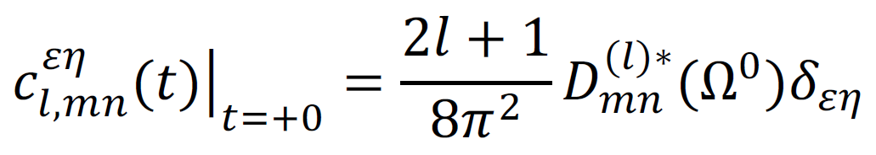
Rotational diffusion of semi-Rigid molecule
Equations for decomposition coefficients
Initial conditions
Formal Solution

Slide 19
Rotational diffusion of semi-Rigid molecule
Equations for decomposition coefficients
Ryabov, Clore, Schwieters (2012)

Slide 20
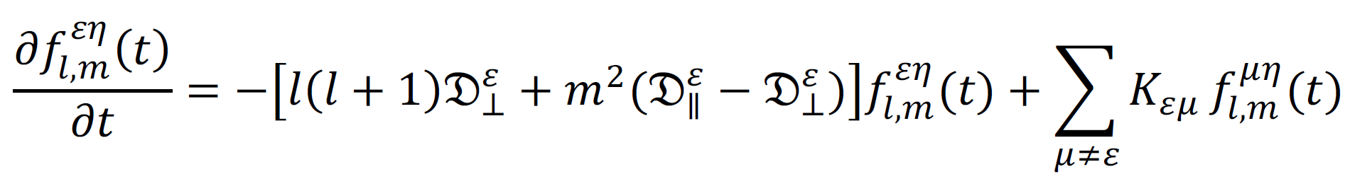
Rotational diffusion of semi-Rigid molecule
Equations for decomposition coefficients (no restrictions)
Ryabov, Clore, Schwieters (2012)
Equations for decomposition coefficients (axial symmetry and co-linearity of the axes of symmetry )
Berne, Pecora (1968); Wong, Case and Szabo (2009)

Slide 21
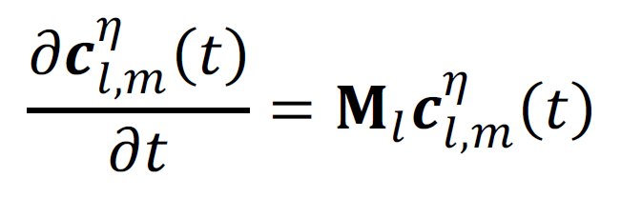
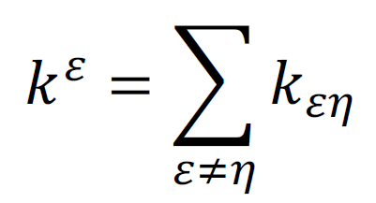
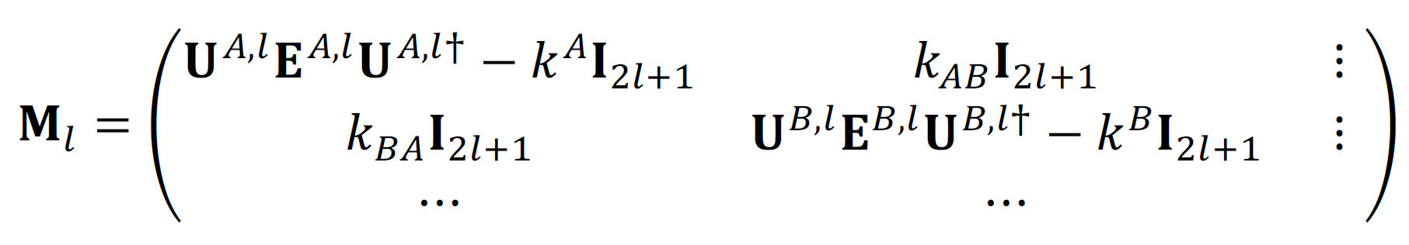
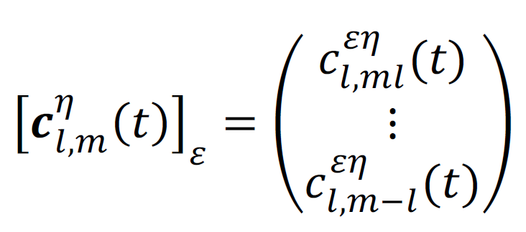
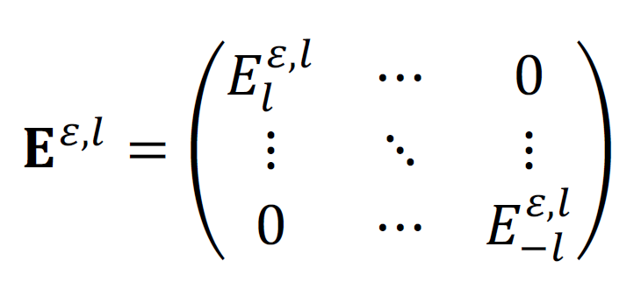
Rotational diffusion of semi-Rigid molecule
Equations for decomposition coefficients
Matrix Form

Slide 22
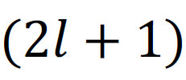
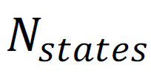
Rotational diffusion of semi-Rigid molecule
Equations for decomposition coefficients
Block dimension

Slide 23

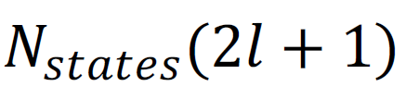


Rotational diffusion of semi-Rigid molecule
Equations for decomposition coefficients
dimension
Dielectric spectroscopy
NMR, ligh scattering

Slide 24


Rotational diffusion of semi-Rigid molecule
Equations for decomposition coefficients
dimension
No solution in closed forms for
Even for and
due to Abel impossibility theorem (1824)

Slide 25
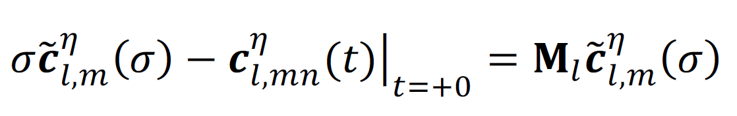

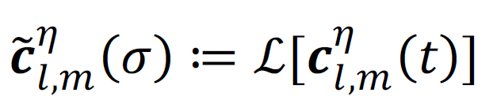
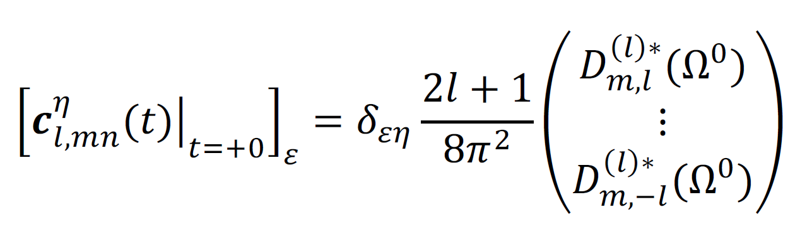
Rotational diffusion of semi-Rigid molecule
Equations for decomposition coefficients
in frequency domain
Complex frequency
Laplace transform
Initial conditions

Slide 26
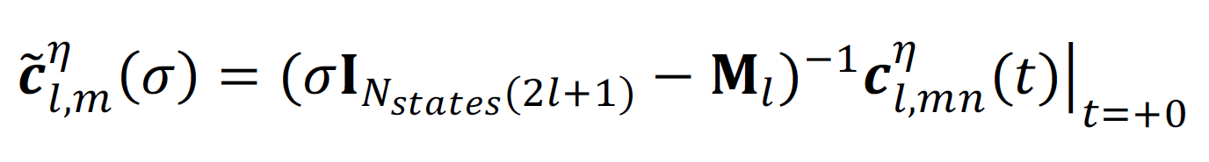
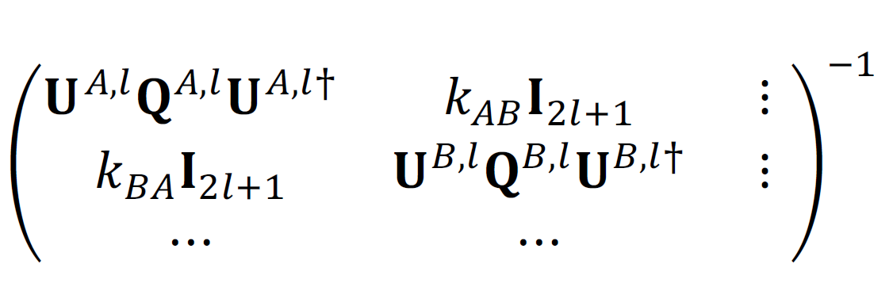
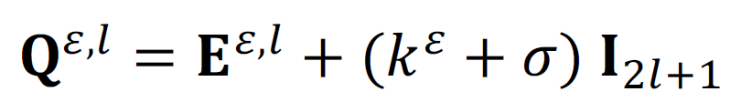
Rotational diffusion of semi-Rigid molecule
Equations for decomposition coefficients
in frequency domain
Matrix inversion does NOT
depend on solving Eigen problem
No restrictions from Abel theorem

Slide 27
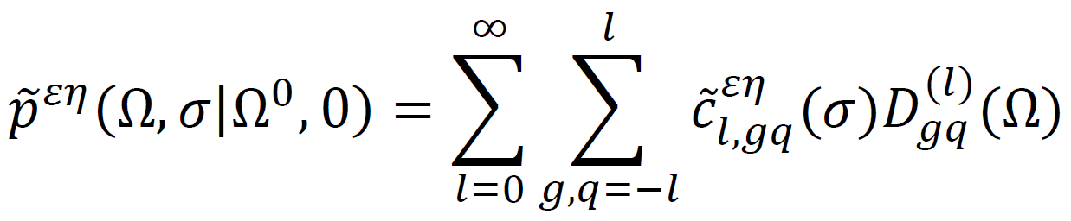
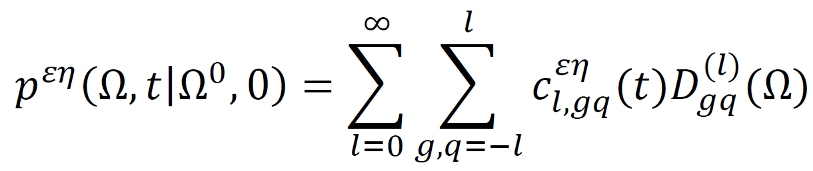
Rotational diffusion of semi-Rigid molecule
Green’s functions in frequency domain
Green’s function in time domain

Slide 28
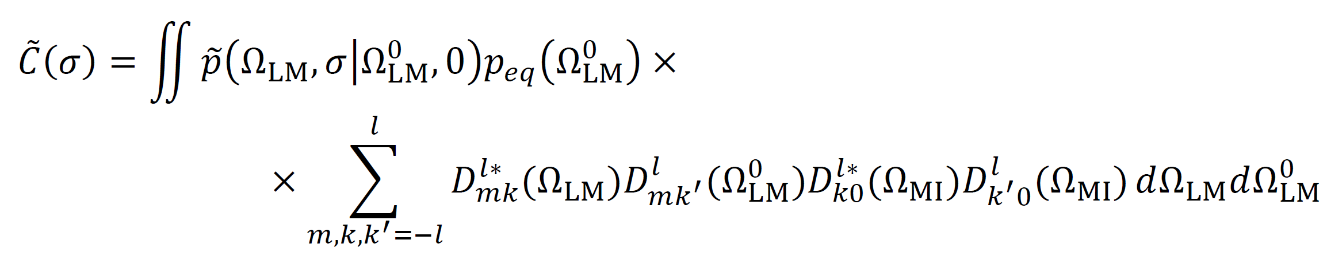

Rotational diffusion of semi-Rigid molecule
Correlation function in frequency domain
Correlation function in time domain

Slide 29


Rotational diffusion of semi-Rigid molecule
Correlation function in frequency domain (no restrictions)
Ryabov, Clore, Schwieters (2012)
Correlation function in time domain (axial symmetry and co-linearity of the axes of symmetry )
Berne, Pecora (1968); Wong, Case and Szabo (2009)

Slide 30

Rotational diffusion of semi-Rigid molecule
Correlation function in frequency domain (no restrictions)
Spectral density
Experimental observables: R1, R2 etc.

Slide 31











Illustrative calculations
Estimations of XplorNIH @ 300 K
EI dimer
Assumptions
Symmetric motions
Equal occupation

Slide 32




Illustrative calculations
NMR relaxation rates for 600 MHz @ 300 K
N- terminus
C- terminus

Slide 33


Illustrative calculations
NMR relaxation rates for 600 MHz @ 300 K

Slide 34


Illustrative calculations
NMR relaxation rates for 600 MHz @ 300 K

Slide 35
Concluding notes
Our Model
Provides closed form solutions in frequency domain ready for evaluation of spectral density etc.
Provides known limiting cases and is reproduced by Monte Carlo simulations
Not universal: discusses only the transitions between discrete states
However, accounts for arbitrary symmetry of diffusion tensors, arbitrary reorientation of molecules upon conformation transition, and coupling between diffusion tumbling and conformation exchange

Slide 36
Acknowledgments
Co-Authors
Charles D. Schwieters
G. Marius Clore
Extremely Useful Discussions
Alexander Berezhkovskii
Attila Szabo

