Slide 1


Yaroslav Ryabov
Making use of random tumbling
or deriving information about protein structures
from the way they move

Slide 2
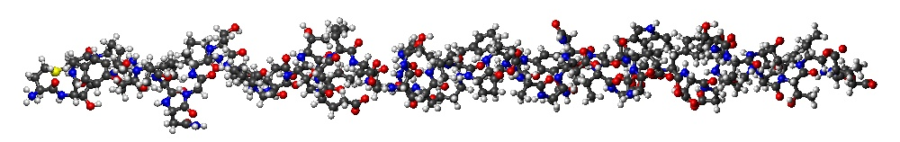
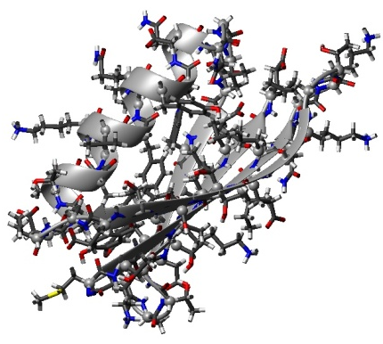
Ultimate Goal of protein structure prediction
Sequence of amino acid residues
+
Model inter atomic forces
=

Slide 3
Ultimate Goal of protein structure prediction
Sequence of amino acid residues
+
Model inter atomic forces
=
Is not yet accomplished

Slide 4
NMR Protein structure determination
Sequence of amino acid residues
+
Experimental restraints: NOE, RDC, and etc.
+
a priori restraints from database of known structures
=

Slide 5
Local and Global restraints
Ideal structure

Slide 6
Local restraints
Δ ~ N
2

Slide 7
Global restraints
Overall shape

Slide 8
Local and Global restraints

Slide 9
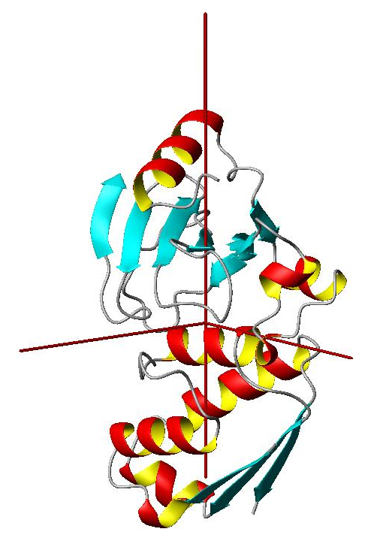
Overall shape restraints from protein dynamics
D_{z}
D_{x}
D_{y}
3 Euler angles for
Diffusion Tensor PAF

Slide 10
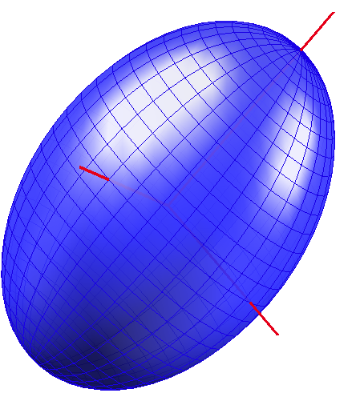
Diffusion Properties of Proteins from ellipsoid model
Why an ellipsoid model ?
Diffusion Tensor
Ellipsoid Shell
A_{z}
One-to-One
mapping
A_{x}
A_{y}
3 Euler angles for
Diffusion Tensor PAF
3 Euler angles for
Ellipsoid orientation

Slide 11
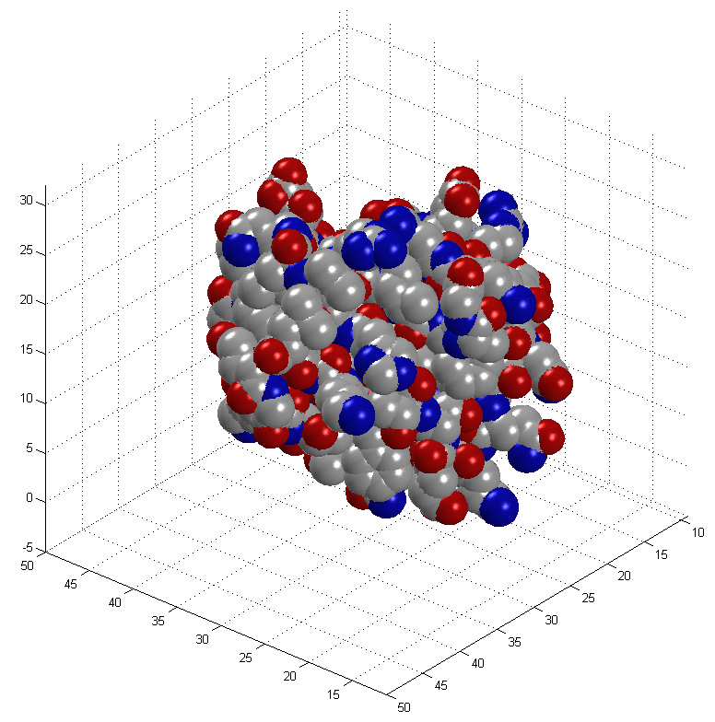
Mapping protein surfaces

Slide 12
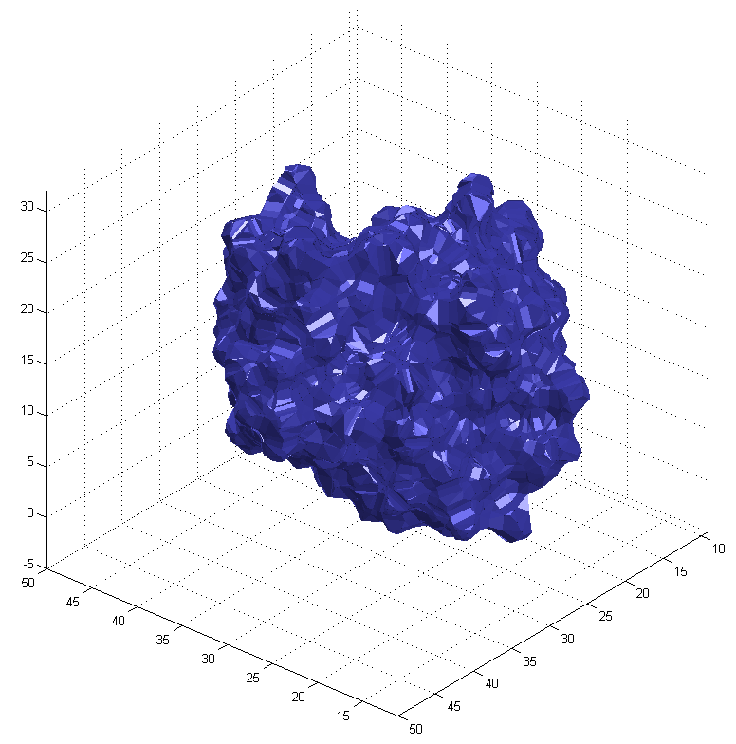
Mapping protein surfaces
SURF program

Slide 13
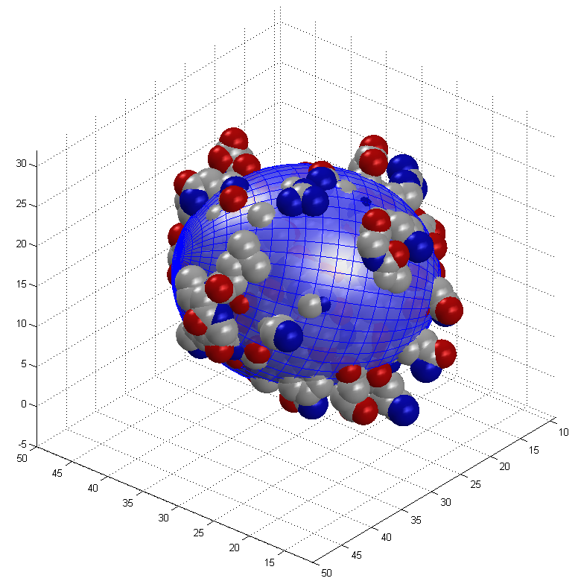
Build equivalent ellipsoid
Principal Component Analysis (PCA)

Slide 14
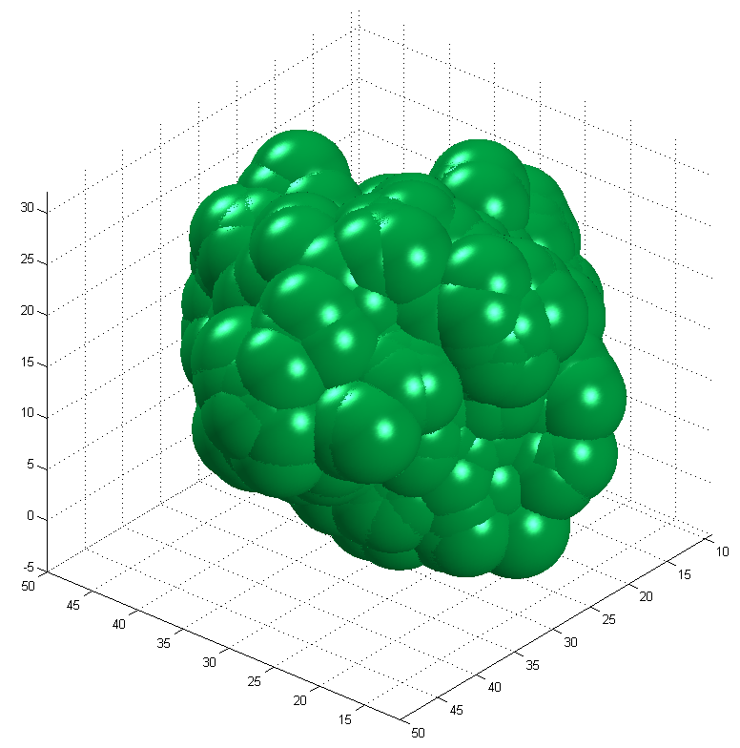
Hydration shell

Slide 15
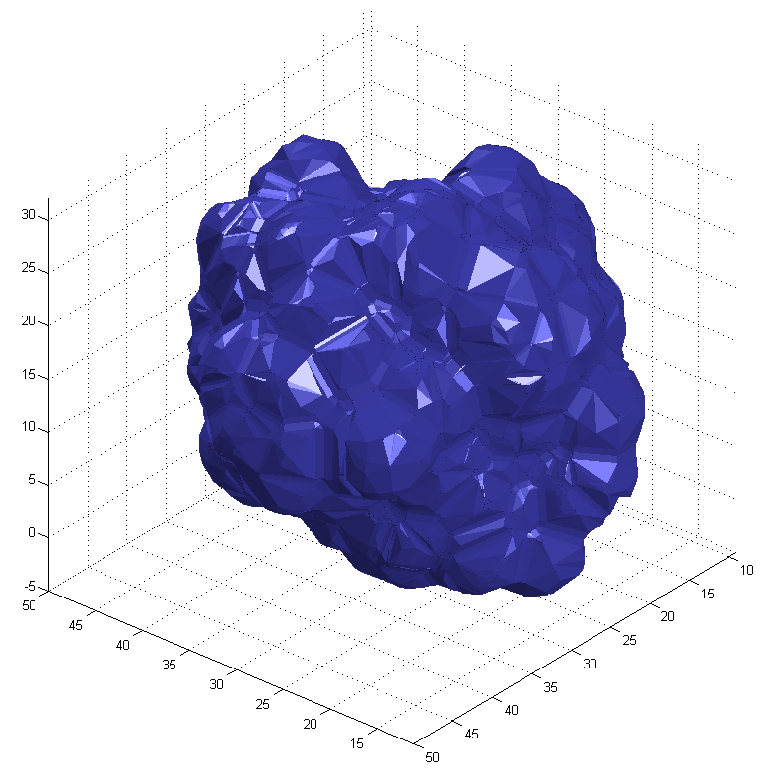
Hydration shell

Slide 16
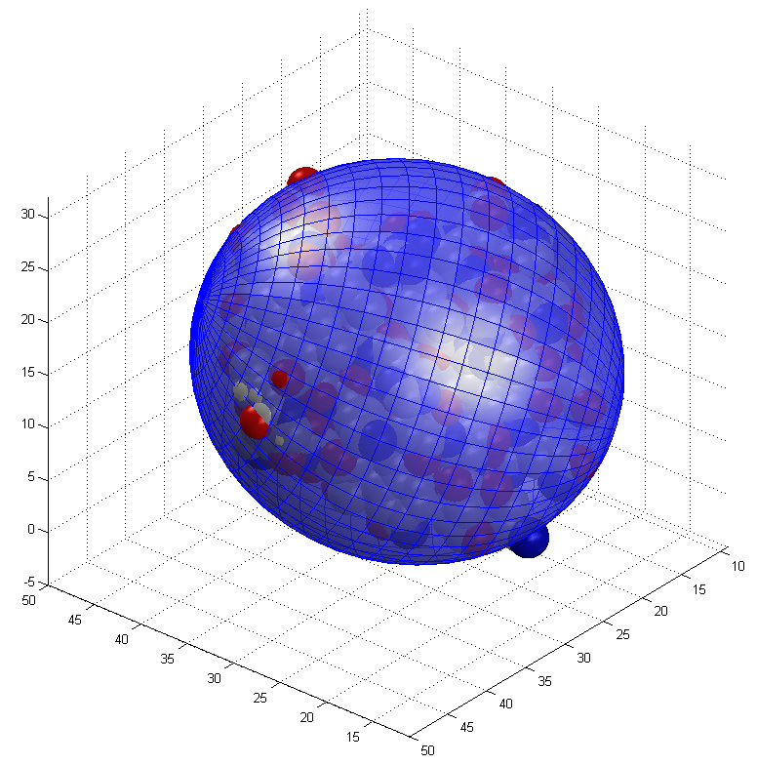
Hydration shell
Equivalent ellipsoid is approximately twice bigger

Slide 17
Comparison with the experimental data

Slide 18
A Very General Concept
During the course of structure elucidation build an equivalent ellipsoid for every snapshot of protein structure conformation
Then calculate parameters of protein diffusion tensor using the equivalent ellipsoid shape
Compare calculated diffusion tensor parameters with those which were derived from the experimental data and establish a pseudo energy term proportional to the sum of square differences between components of calculated and experimental diffusion tensors

Slide 19
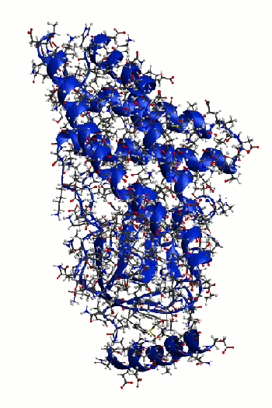
Refinement of a protein structure with Xplor-NIH
using overall shape restraints from diffusion tensor
N terminal domain from Enzyme I (EIN)
Standard Xplor-NIH simulated annealing protocol started from 3000K down to 25 K
With 12.5 K steps
Experimental restraints:
distance restraints derived from NOE
and
Components of Rotation Diffusion Tensor
10 lowest energy structures: Blue with diffusion tensor restraints
Green without diffusion tensor restraints

Slide 20
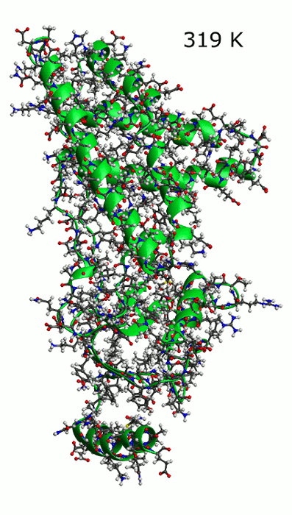
Effect of temperature settings for diffusion tensor term
Uncertainties in
Thickness of hydration layer
Sample viscosity
Sample temperature
Could be compensated by adjustment of setup for
“Experimental” temperature

Slide 21
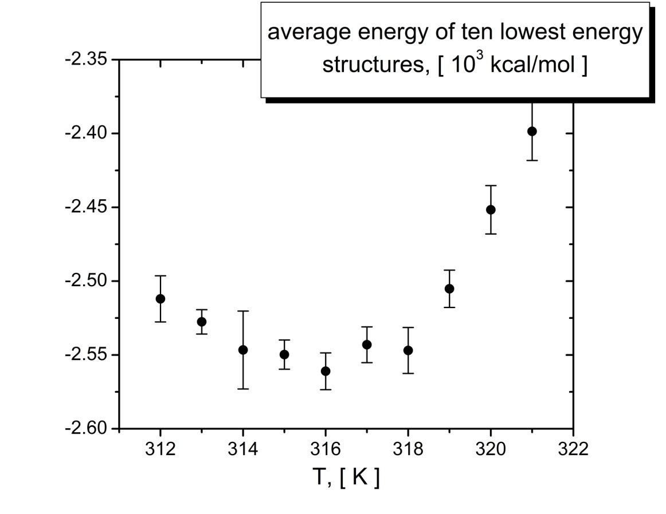
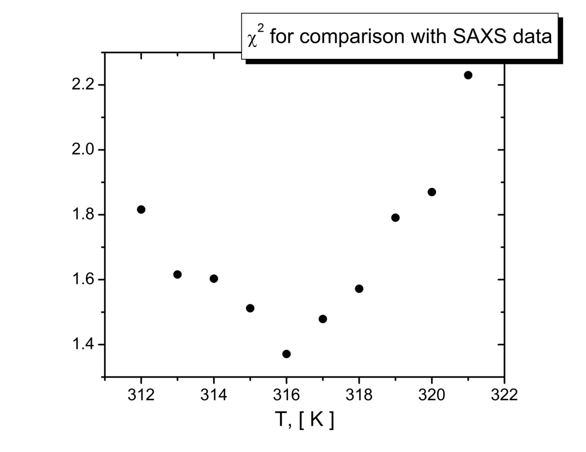
Effect of temperature settings for diffusion tensor term
Experimental temperature: 313 K
Temperature of the minimum: 316 K
Uncertainties in
thickness of hydration layer, sample temperature, and sample viscosity

Slide 22
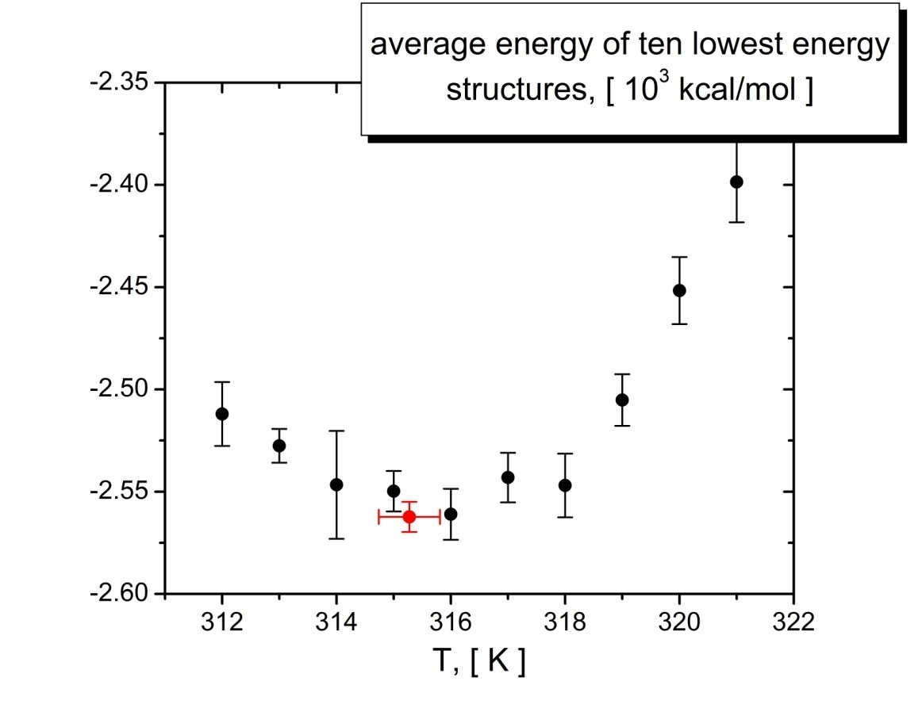
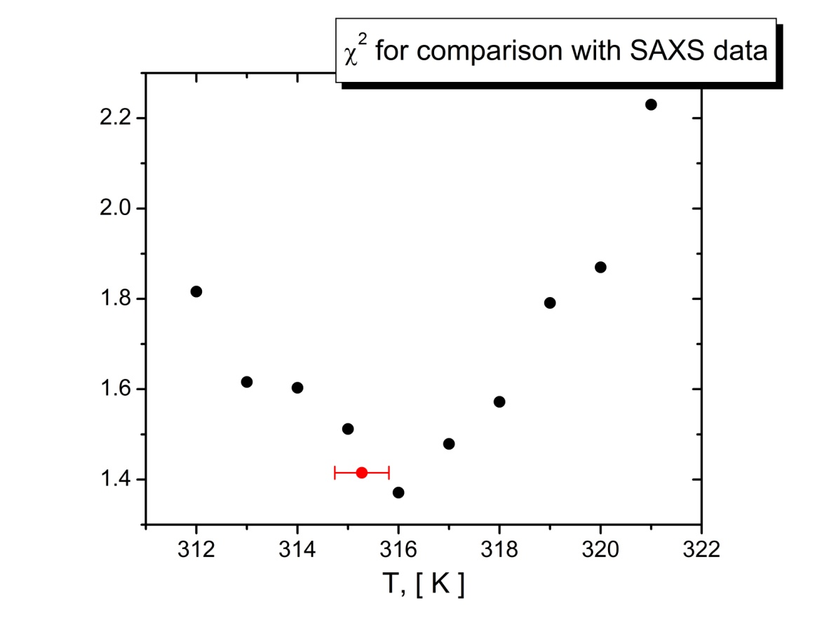
Effect of temperature settings for diffusion tensor term
Experimental temperature: 313 K Optimized Temperature: 315.3 ± 0.5
Temperature of the minimum: 316 K
Uncertainties in
thickness of hydration layer, sample temperature, and sample viscosity

Slide 23
Assembling structures of multi domain proteins
using the overall shape restraints provided by the diffusion tensor
Global restraints on Overall shape

Slide 24
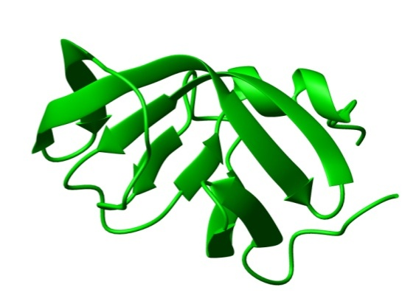
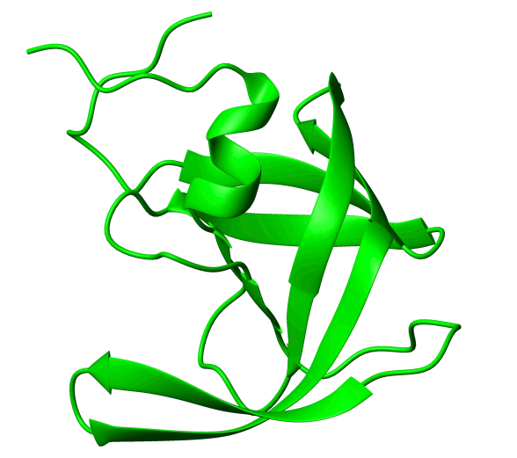
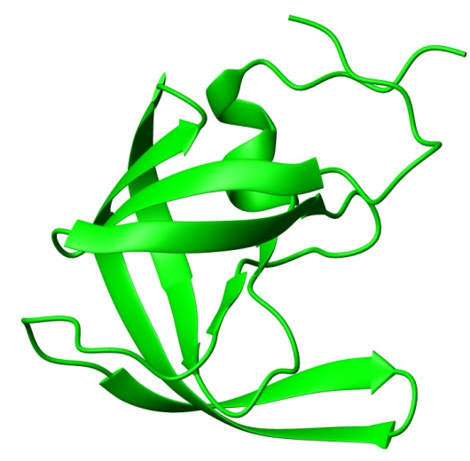
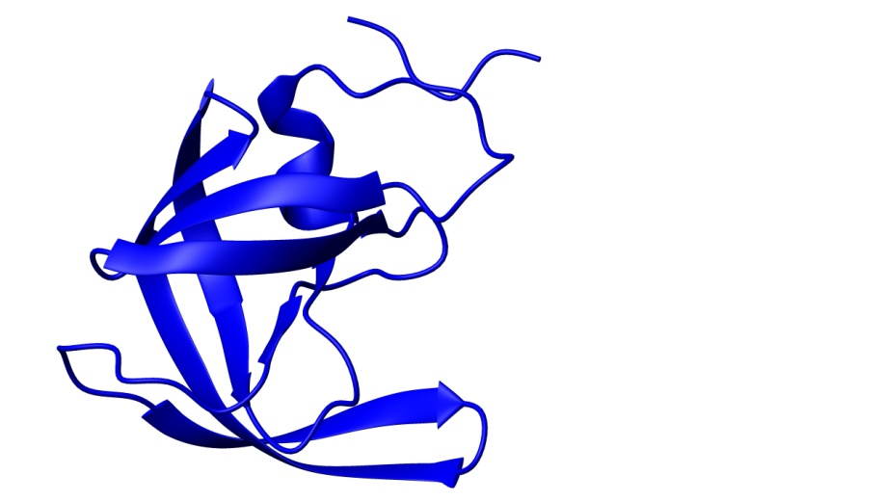
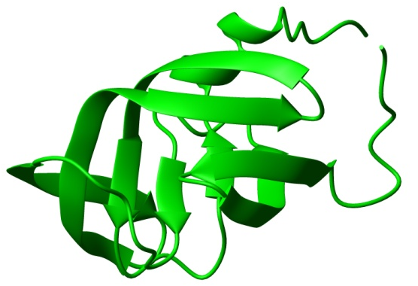
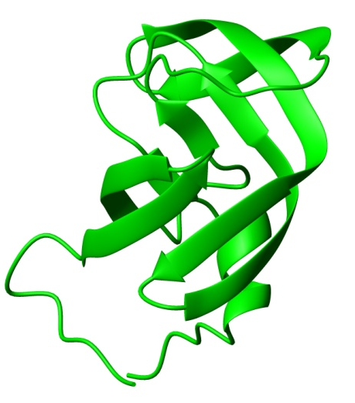
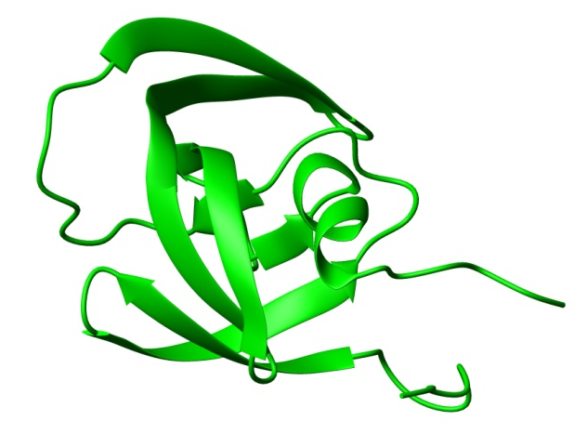
Assembling structure of a symmetric protein homo dimer
HIV -1 protease

Slide 25
Assembling structure of a symmetric protein homo dimer
Generic docking protocol
Part I:
Rigid body dynamics
for raw domain positioning.
Part II:
Simulated annealing
with flexible side chains
for final adjustment.

Slide 26
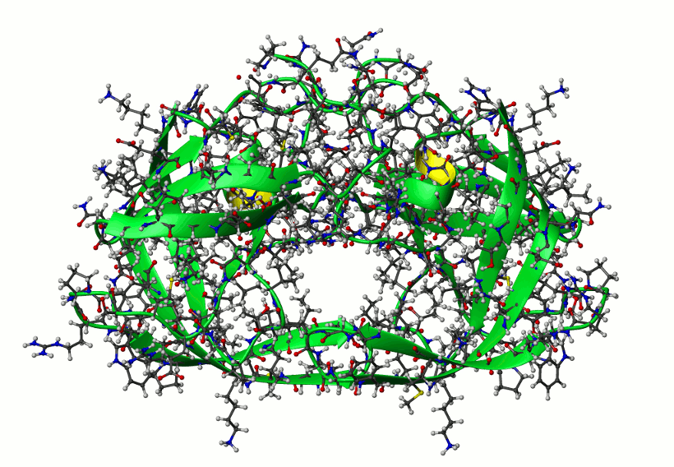
Assembling structure of a symmetric protein homo dimer
HIV -1 protease
Randomization of domain positions
and Rigid body dynamics repeated 10 times;
then the lowest energy structure submitted to final simulated annealing part of the protocol
512 structures calculated.
The only experimental restrains are
Components of Rotation Diffusion Tensor
10 lowest energy structures

Slide 27
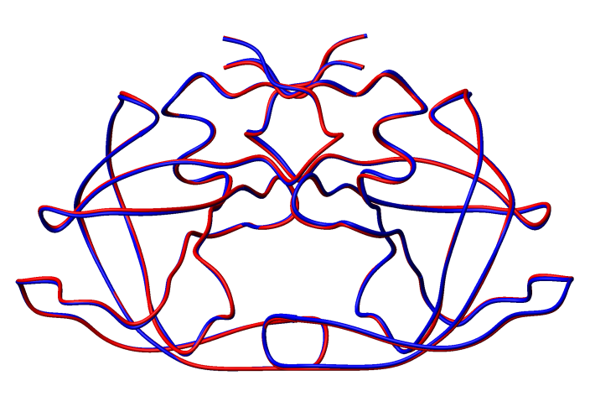
Assembling structure of a symmetric protein homo dimer
HIV -1 protease
10 lowest energy structures
Averaged over 10 lowest energy structures (blue) versus reference (red)
Cα RMSD 0.35 ±0.09 [Å]

Slide 28
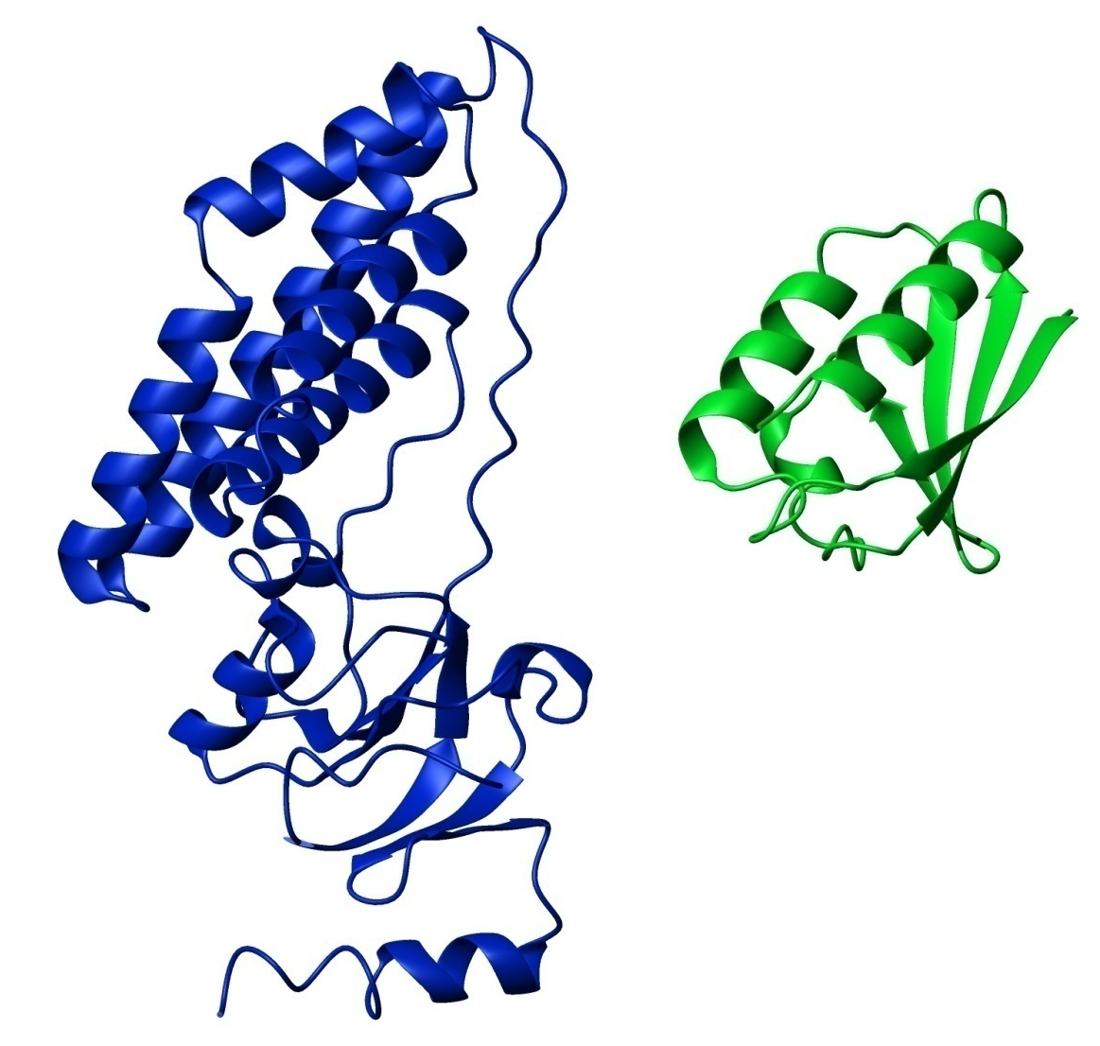
Application to an asymmetric complex
EIN – HPr complex

Slide 29
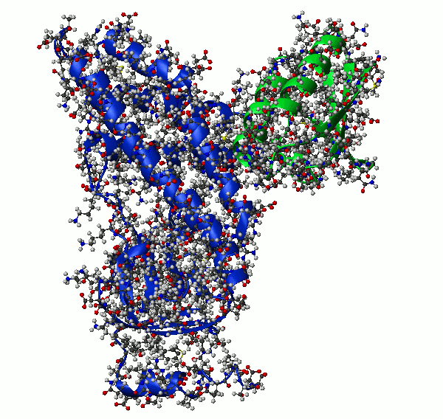
Application to an asymmetric complex
EIN – HPr complex
10 lowest energy structures

Slide 30
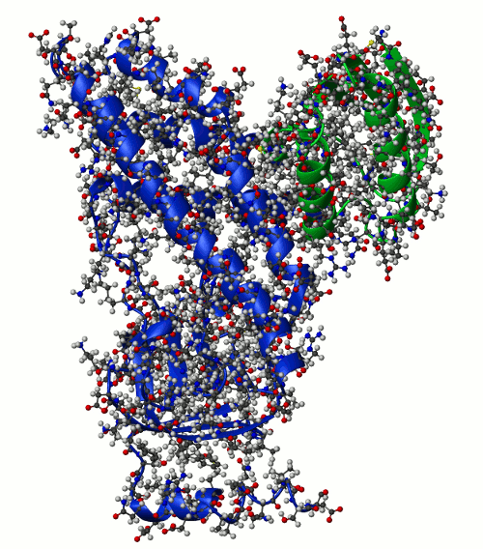
Application to an asymmetric complex
EIN – HPr complex
10 lowest energy structures

Slide 31
Application to an asymmetric complex
EIN – HPr complex
Randomization of domain positions
and Rigid body dynamics repeated 10 times; then the lowest energy structure submitted to final simulated annealing part of the protocol
512 structures calculated.
Experimental restrains were
Components of Rotation Diffusion Tensor
and
Highly ambiguous distance restraints from chemical shift perturbation mapping
10 lowest energy structures

Slide 32
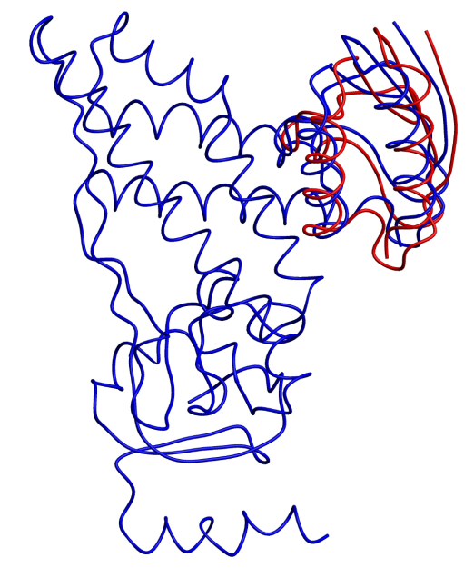
Application to an asymmetric complex
EIN – HPr complex
10 lowest energy structures
Cα RMSD 1.20 ±0.03 [Å]

Slide 33
CONCLUSIONS
Accuracy of the structures obtained using shape restraints derived from protein rotation tensor is comparable to the accuracy of standard structure determination protocols.
When refining structures of globular proteins, these restraints, in combination with other information, could help to solve the problem of poor packing density of NMR protein structures.
When assembling protein complexes, the relaxation data even for one domain of the complex are enough to drive accurate domain assembly.
In some cases these restraints can be the only experimental information necessary to obtain correct domain assembly.

Slide 34
ACKNOWLEDGMENTS
Co-authors of the paper: Jeong-Yong Suh,
Alexander Grishaev,
JACS 131 (2009) p.9522 G. Marius Clore,
Charles D. Schwieters
For the help Daniel Garrett
with the NMR data on EIN
For the help John Kuszewski
with Xplor-NIH code
For funding National Research Council

Slide 35
ACKNOWLEDGMENTS
For all
DCB
for warm, friendly and cooperative working environment !

Slide 36
Current project
Orientation information from residue specific NMR
Relaxation rates

