Slide 1


Methods of Protein Structure Elucidation
Yaroslav Ryabov

Slide 2
Main goals of
Computational Biology
Advance understanding of biological processes
And eventually provide new drugs
By using modern computational technologies

Slide 3
There is still no a single drug on the market
that was designed exclusively by a computer
But …
Publications on Computer Drug Discovery subject

Slide 4
Utility of computational methods in drug discovery
The cost of drug discovery and development
$800 million dollars
Time to market approximately 12 years

Slide 5
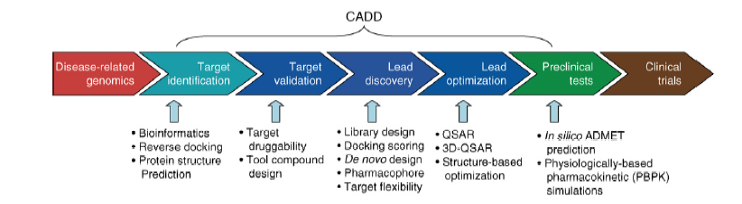
Drug discovery pipeline
And Computer Assisted Drug Design tools.
QSAR Quantitative structure-activity relationship
ADME Absorption, Distribution, Metabolism, Excretion and Toxicology

Slide 6
Drug discovery pipeline
And Computer Assisted Drug Design tools.
QSAR Quantitative structure-activity relationship
ADME Absorption, Distribution, Metabolism, Excretion and Toxicology

Slide 7
Getting protein structures
Imaging methods
X-ray crystallography, Cryo-Electron microscopy
Computational methods
Structure Predictions and Structure Elucidation

Slide 8
Protein structure prediction
Sequence of amino-acid residues for streptococcal Protein GB1
MET THR TYR LYS LEU ILE LEU ASN GLY LYS THR LEU LYS GLY GLU THR THR THR GLU ALA VAL ASP ALA ALA THR ALA GLU LYS VAL PHE LYS GLN TYR ALA ASN ASP ASN GLY VAL ASP GLY GLU TRP THR TYR ASP ASP ALA THR LYS THR PHE THR VAL THR GLU

Slide 9
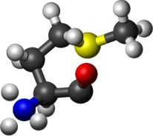
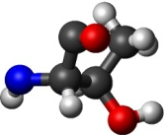
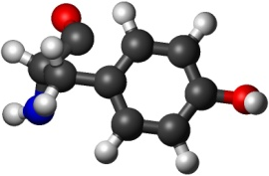
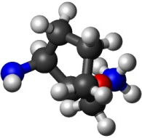
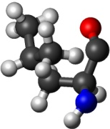
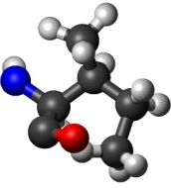
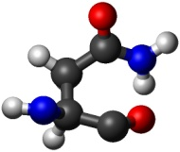
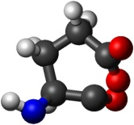
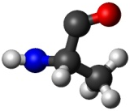
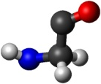
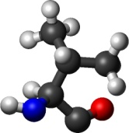
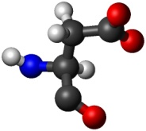
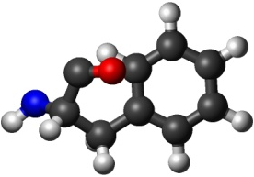
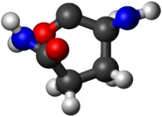
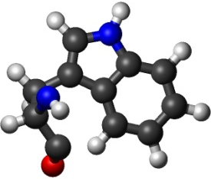
Protein structure prediction
Structures of amino-acid residues are known
MET
THR
TYR
LYS
LEU
ILE
ASN
GLY
GLU
ALA
VAL
ASP
PHE
GLN
TRP

Slide 10
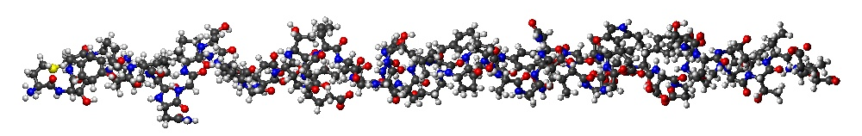
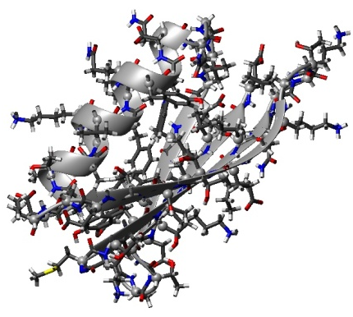
Protein structure prediction
The Goal
Use Extended strand
Which is build using structures of amino-acid residues
+
Model inter molecular Force fields (CHARMM)
=

Slide 11
Protein structure prediction
The Goal
Use Extended strand
Which is build using structures of amino-acid residues
+
Model inter molecular Force fields (CHARMM)
=
Is yet to accomplish

Slide 12
Structure elucidation
Use Extended strand
Which is build using structures of amino-acid residues
+
Model inter molecular Force fields (CHARMM)
+
Experimental restraints: NOE, RDC, T1 and T2, etc.
=

Slide 13
Local and Global restraints
Ideal structure

Slide 14
Local restraints
Δ ~ N
2

Slide 15
Global restraints
Overall shape

Slide 16
Local and Global restraints

Slide 17
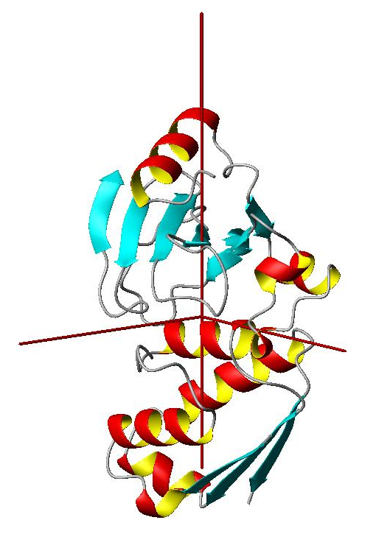
Overall shape restraints from protein dynamics
D_{z}
D_{x}
D_{y}
3 Euler angles for
Diffusion Tensor PAF

Slide 18
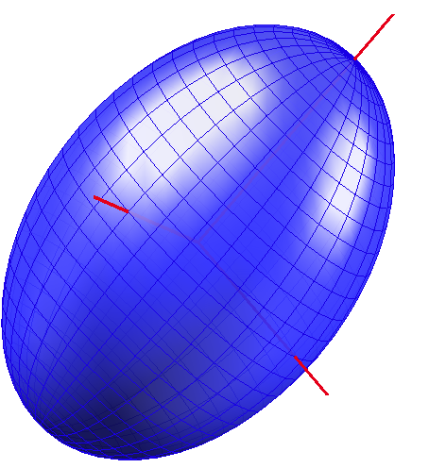
Diffusion Properties of Proteins from ellipsoid model
Why an ellipsoid model ?
Diffusion Tensor
Ellipsoid Shell
A_{z}
One-to-One
mapping
A_{x}
A_{y}
3 Euler angles for
Diffusion Tensor PAF
3 Euler angles for
Ellipsoid orientation

Slide 19
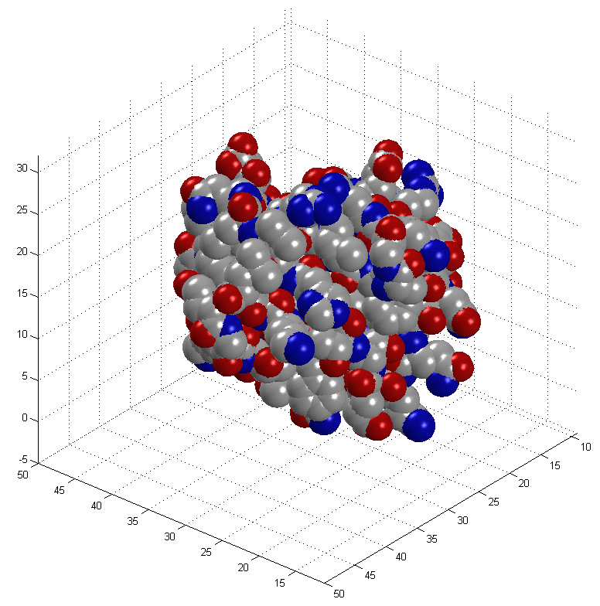
Mapping protein surfaces

Slide 20
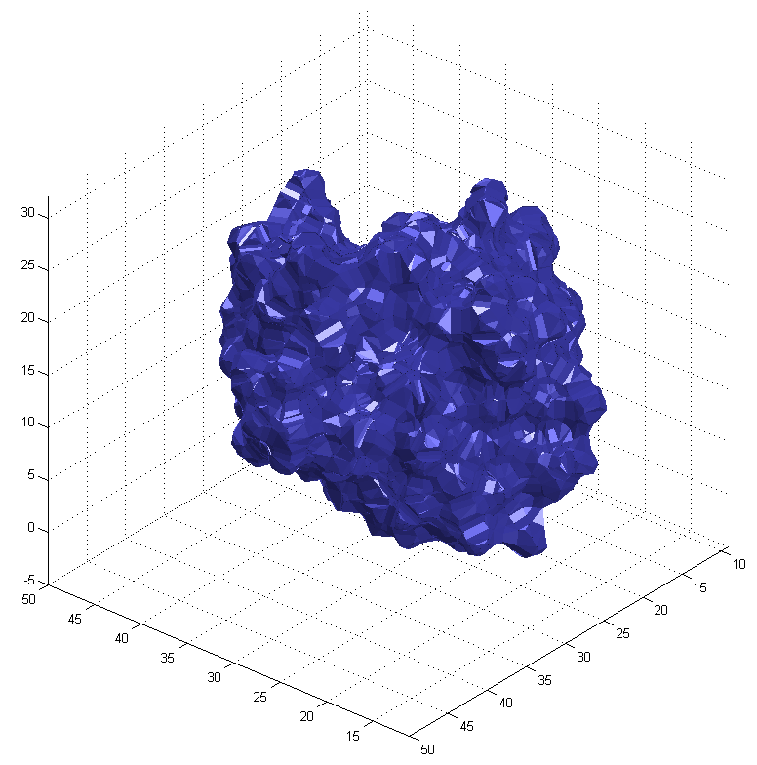
Mapping protein surfaces
SURF program

Slide 21
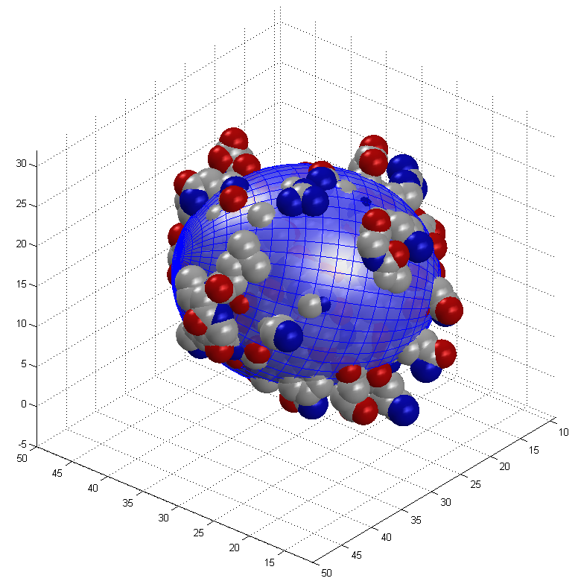
Build equivalent ellipsoid
Principal Component Analysis (PCA)

Slide 22
Comparison with the experimental data

Slide 23
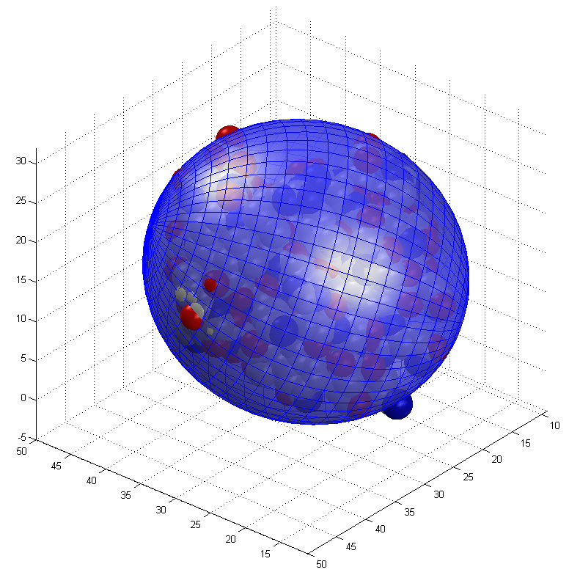
A Very General Concept
During the course of structure elucidation build an equivalent ellipsoid for every snapshot of protein structure conformation
Then calculate parameters of protein diffusion tensor using the equivalent ellipsoid shape
Compare calculated diffusion tensor parameters with those which were derived from the experimental data and establish a pseudo energy term proportional to the sum of square differences between components of calculated and experimental diffusion tensors

Slide 24
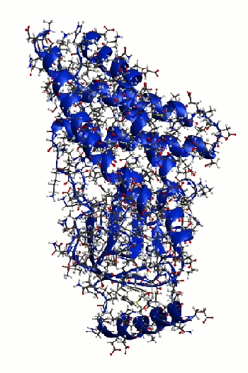
Refinement of a protein structure with Xplor-NIH
using overall shape restraints from diffusion tensor
N terminal domain from Enzyme I (EIN)
Standard Xplor-NIH simulated annealing protocol started from 3000K down to 25 K
with 12.5 K steps
Experimental restraints:
distance restraints derived from NOE
and
Components of Rotation Diffusion Tensor
10 lowest energy structures: Blue with diffusion tensor restraints
Green without diffusion tensor restraints

Slide 25
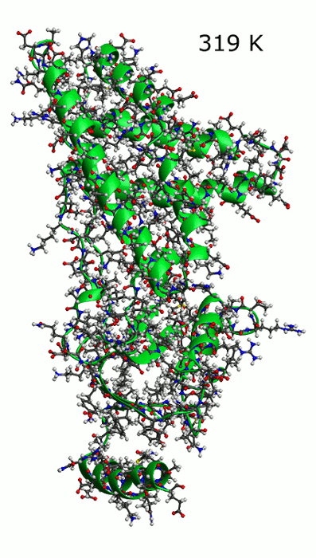
Effect of temperature variations on protein structure

Slide 26
Assembling structures of multi domain proteins
using the overall shape restraints provided by the diffusion tensor
Global restraints on Overall shape

Slide 27
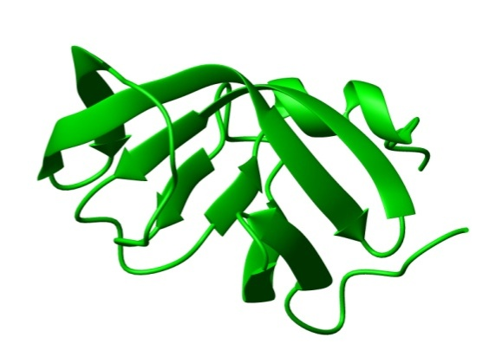
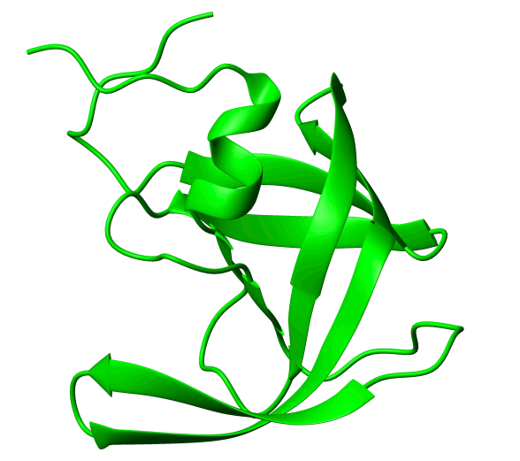
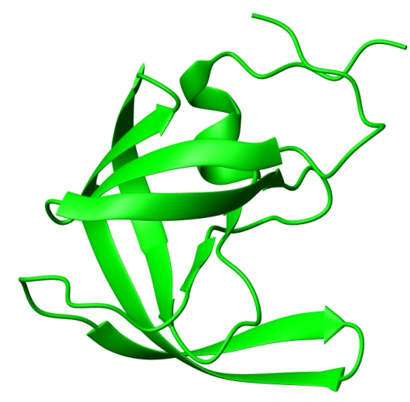
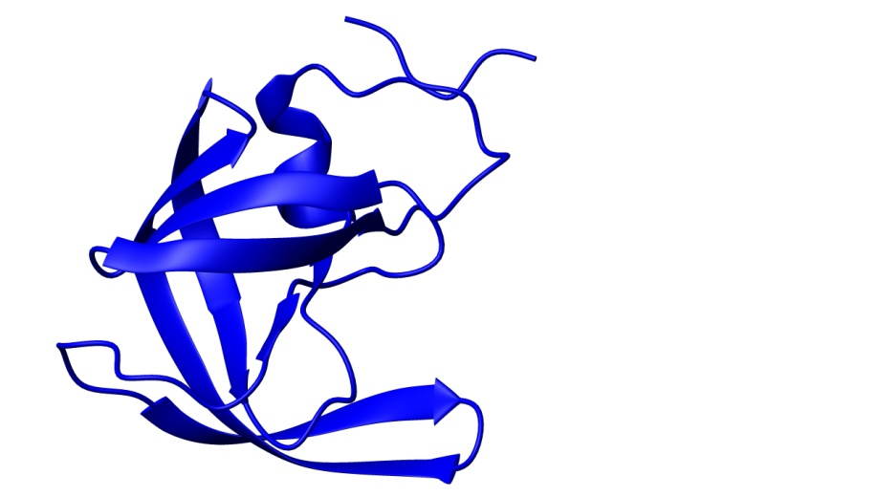
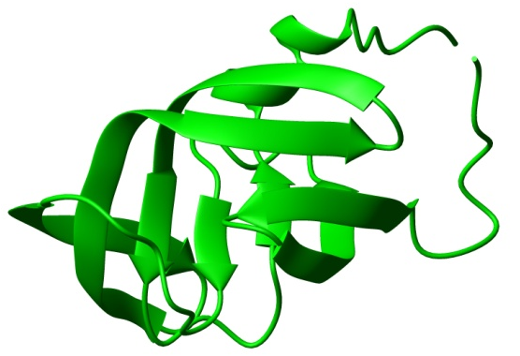
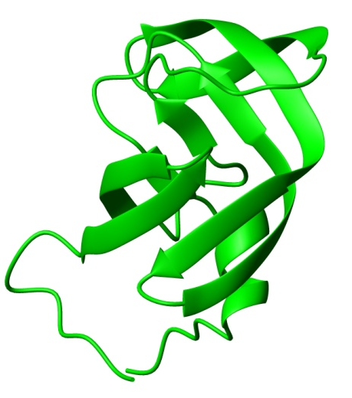
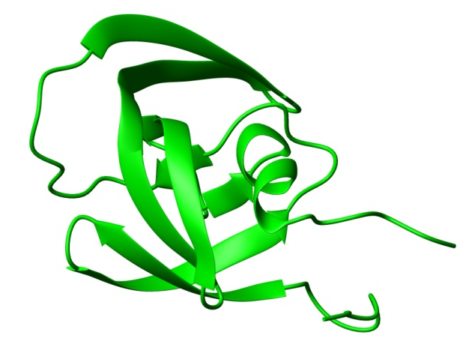
Assembling structure of a symmetric protein homo dimer
HIV -1 protease

Slide 28
Assembling structure of a symmetric protein homo dimer
Generic docking protocol
Part I:
Rigid body dynamics
for raw domain positioning.
Part II:
Simulated annealing
with flexible side chains
for final adjustment.

Slide 29
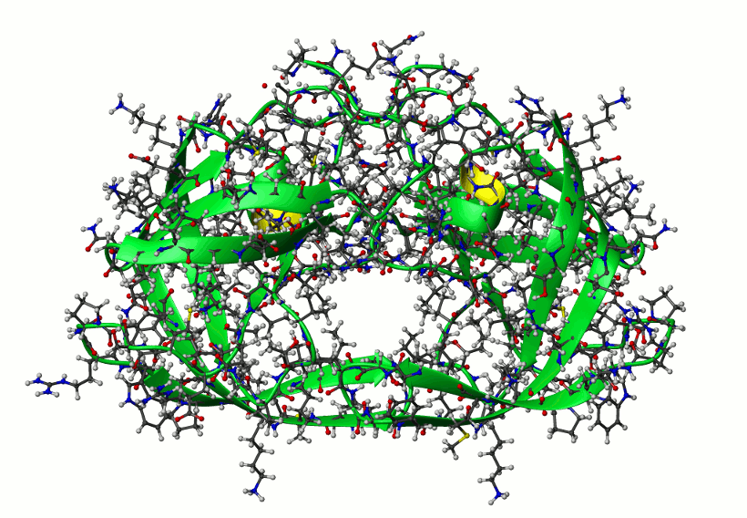
Assembling structure of a symmetric protein homo dimer
HIV -1 protease
Randomization of domain positions
and Rigid body dynamics repeated 10 times;
then the lowest energy structure submitted to final simulated annealing part of the protocol
512 structures calculated.
The only experimental restrains are
Components of Rotation Diffusion Tensor
10 lowest energy structures

Slide 30
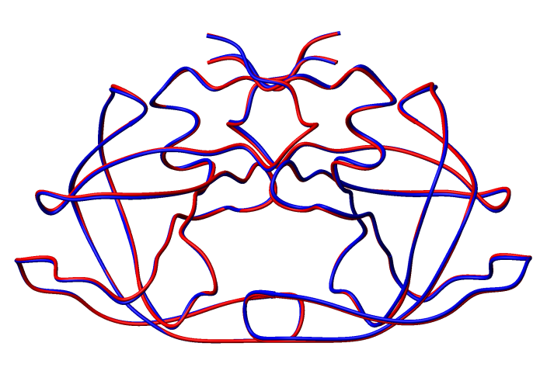
Assembling structure of a symmetric protein homo dimer
HIV -1 protease
10 lowest energy structures
Averaged over 10 lowest energy structures (blue) versus reference (red)
Cα RMSD 0.35 ±0.09 [Å]

Slide 31
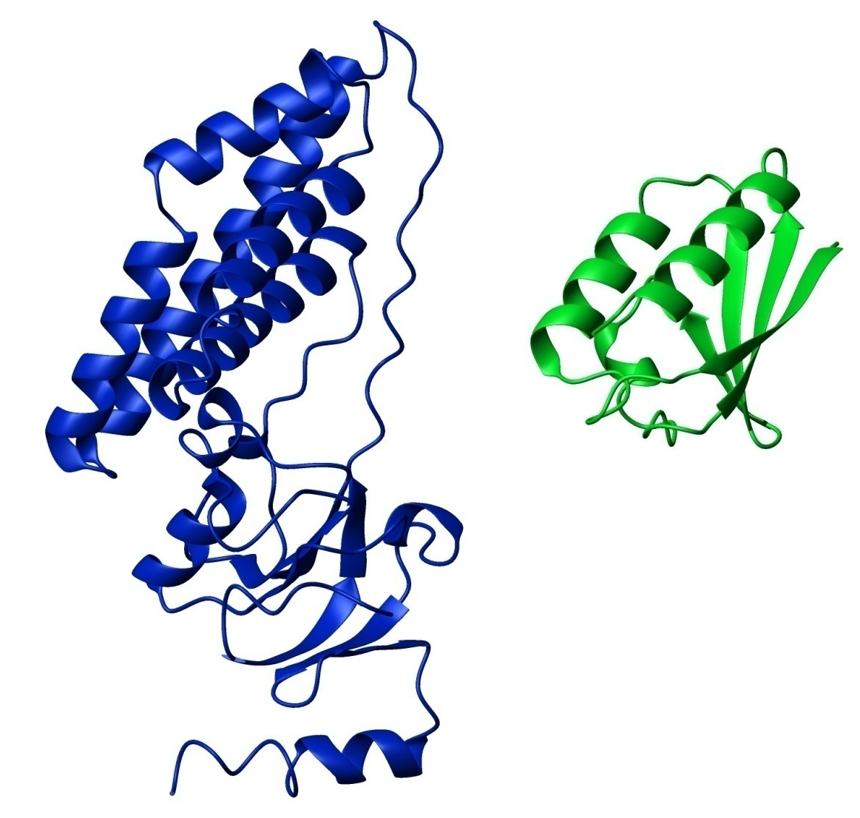
Application to an asymmetric complex
EIN – HPr complex

Slide 32
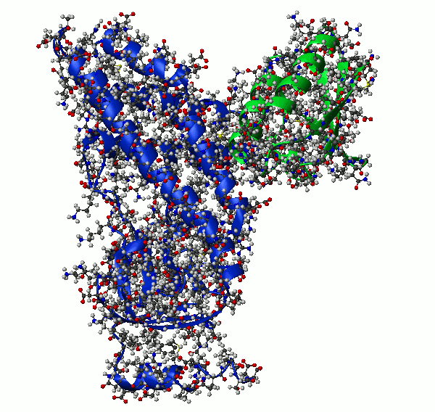
Application to an asymmetric complex
EIN – HPr complex
10 lowest energy structures

Slide 33
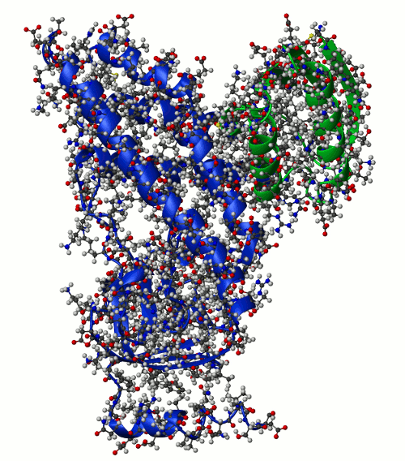
Application to an asymmetric complex
EIN – HPr complex
10 lowest energy structures

Slide 34
Application to an asymmetric complex
EIN – HPr complex
Randomization of domain positions
and Rigid body dynamics repeated 10 times; then the lowest energy structure submitted to final simulated annealing part of the protocol
512 structures calculated.
Experimental restrains were
Components of Rotation Diffusion Tensor
and
Highly ambiguous distance restraints from chemical shift perturbation mapping
10 lowest energy structures

Slide 35
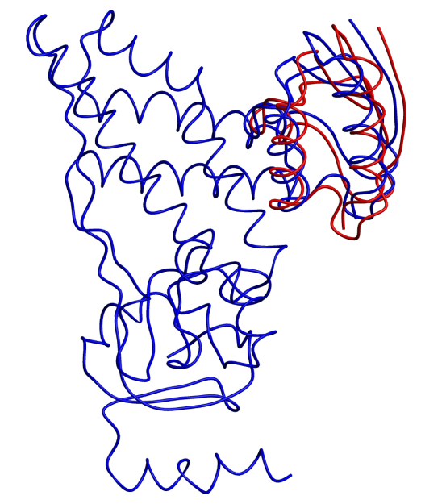
Application to an asymmetric complex
EIN – HPr complex
10 lowest energy structures
Cα RMSD 1.20 ±0.03 [Å]

Slide 36

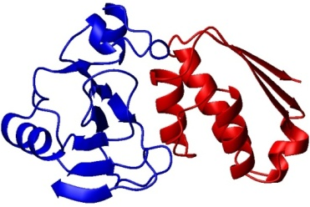
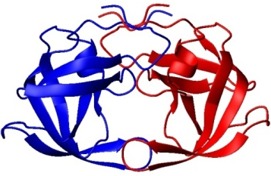
XPLOR-NIH structure elucidation platform
Originated from Axel T Brunger’s X-PLOR package
to CARMM molecular dynamics engine (1987)
Currently developed by
Charles D. Scweiters , G. Marius Clore , Nico Tjandra, and John Kuszewski @ NIH
Experimental data
Inter molecular force Field
XPLOR-NIH
Data base potentials

