Slide 1


Yaroslav Ryabov
Structural information
from protein dynamics:
restraints on protein shape encoded in
protein rotational diffusion tensor

Slide 2
OUTLINE
A very general concept of protein structure elucidation:
Local and global structural restraints.
Global restraints on protein shape from protein dynamics:
Efficient calculations of protein diffusion tensor.
Refinement of globular protein structure using overall shape
restraints encoded in protein diffusion tensor.
Docking domains in protein complexes.
Future directions.

Slide 3
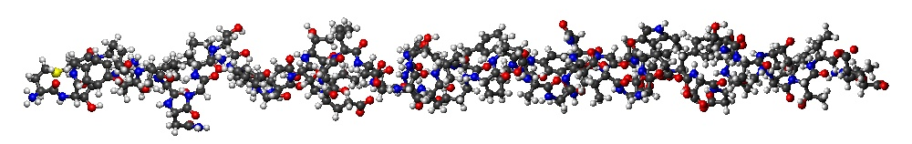
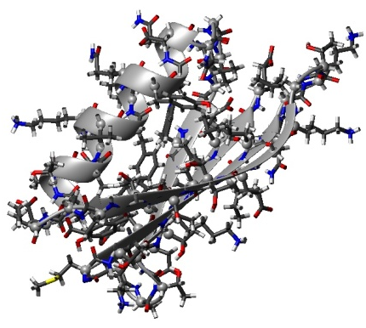
Ultimate Goal of protein structure prediction
Sequence of amino acid residues
+
Model inter atomic forces
=

Slide 4
Ultimate Goal of protein structure prediction
Sequence of amino acid residues
+
Model inter atomic forces
=
Is not yet accomplished

Slide 5
NMR Protein structure determination
Sequence of amino acid residues
+
Experimental restraints: NOE, RDC, and etc.
+
a priori restraints from database of known structures
=

Slide 6
Local and Global restraints
Ideal structure

Slide 7
Local restraints
Δ ~ N
2

Slide 8
Global restraints
Overall shape

Slide 9
Local and Global restraints

Slide 10
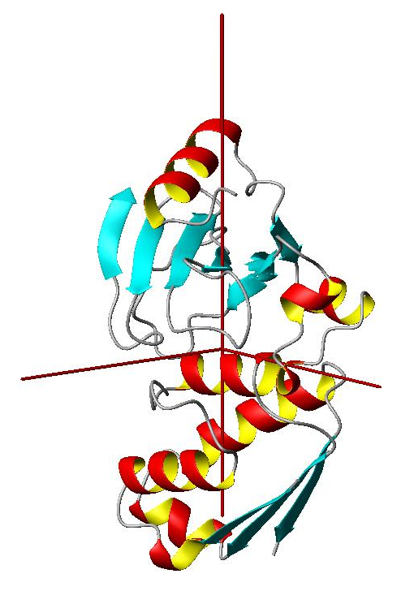
Overall shape restraints from protein dynamics
D_{z}
D_{x}
D_{y}
3 Euler angles for
Diffusion Tensor PAF

Slide 11
Using information about proteins shape encoded in protein rotation diffusion tensor for protein structure determination requires fast and accurate method for calculation protein rotation diffusion tensor for a given protein conformation

Slide 12
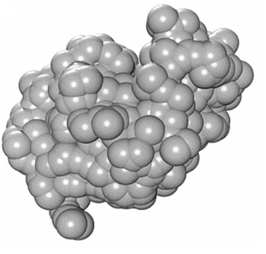
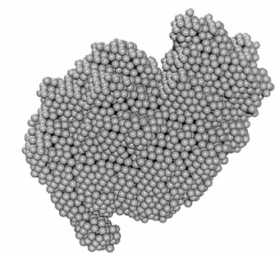
Modeling Diffusion Properties of Proteins
Bead algorithms
Extrapolation for Bead size zero
10 000 beads
J. Garcia de la Torre et al., J Mag Res 147, 138–146 (2000)

Slide 13
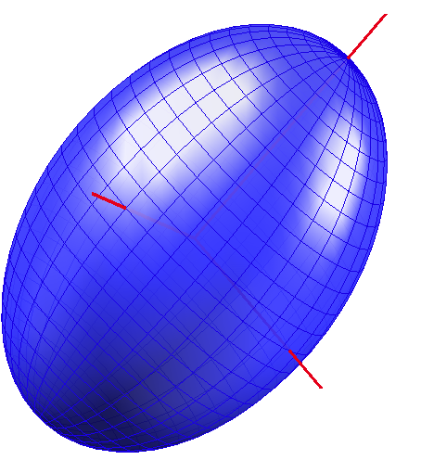
Diffusion Properties of Proteins
from ellipsoid model
Why an ellipsoid model ?
Diffusion Tensor
Ellipsoid Shell
A_{z}
One-to-One
mapping
A_{x}
A_{y}
3 Euler angles for
Diffusion Tensor PAF
3 Euler angles for
Ellipsoid orientation

Slide 14
Diffusion Properties of Proteins
from ellipsoid model
Main problem:
How to build the ellipsoid shell for a protein structure ?
State of the art: Inertia-equivalent ellipsoids
Å
Inertia is irrelevant for protein diffusion
Cantor & Schimmel (1980)

Slide 15
Diffusion Properties of Proteins
from ellipsoid model
Diffusion process related to friction
The friction occurs at protein surface
Proposal
Let us use topology of protein surface to derive
Equivalent ellipsoid for protein
Ryabov et al., JACS (2006)

Slide 16
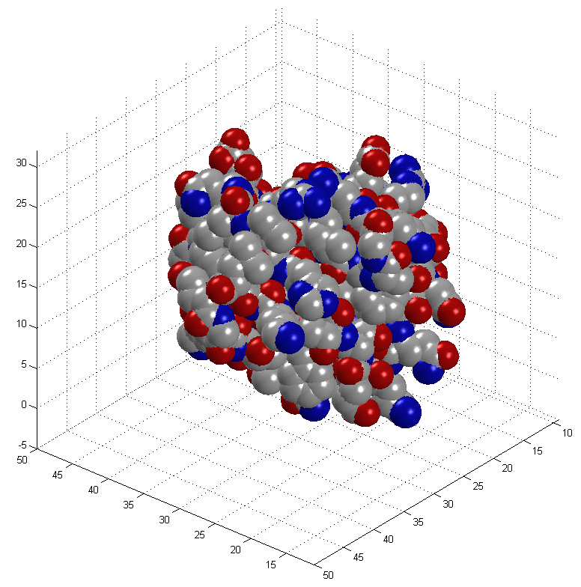
Mapping protein surfaces

Slide 17
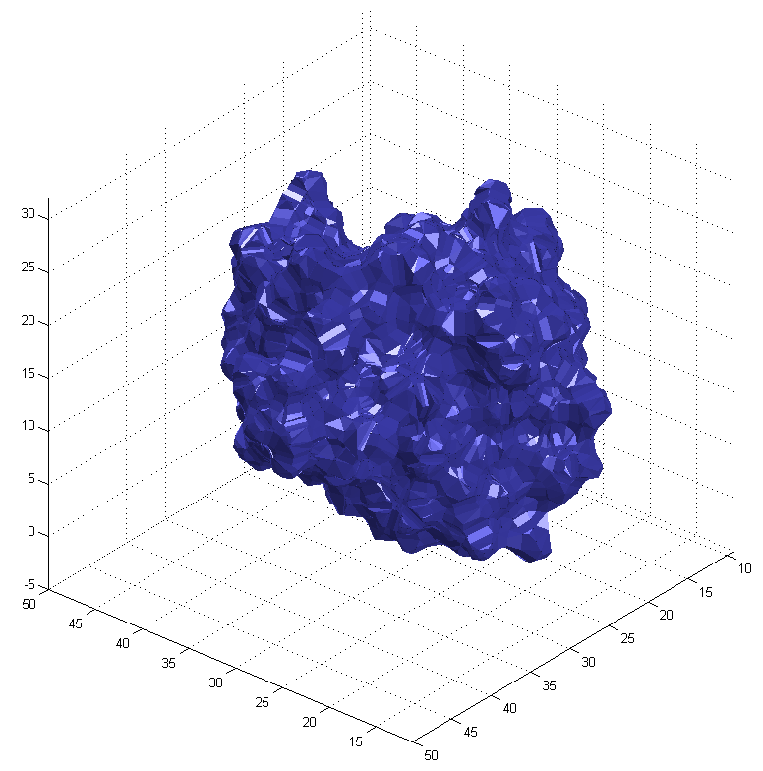
Mapping protein surfaces
SURF program

Slide 18
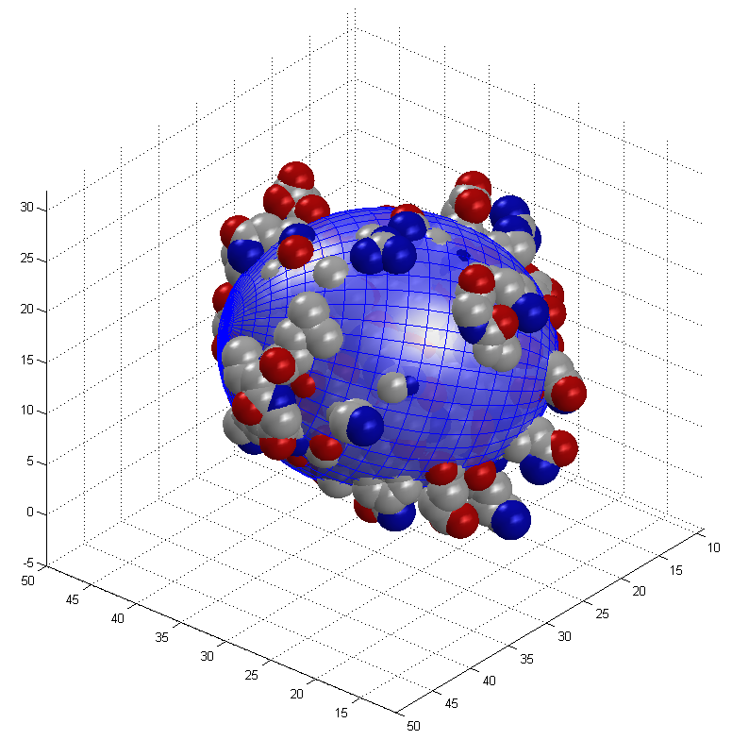
Build equivalent ellipsoid
Principal Component Analysis (PCA)

Slide 19
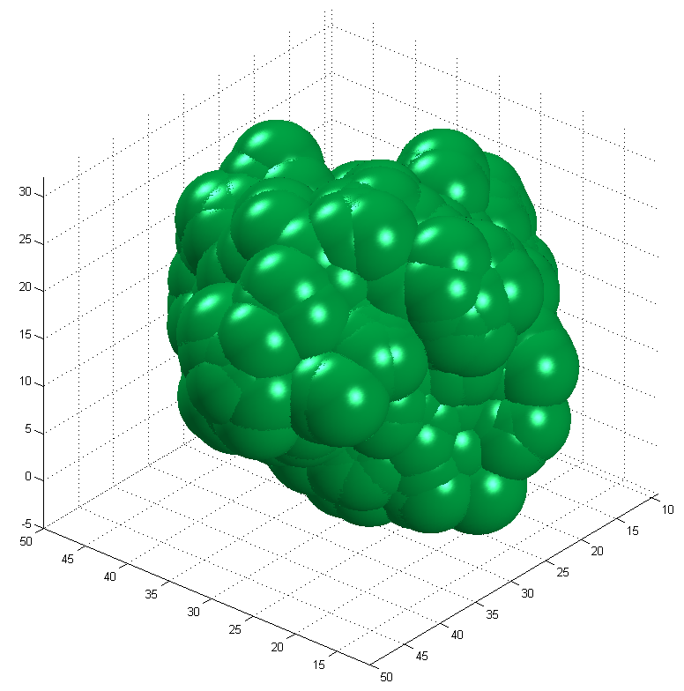
Hydration shell

Slide 20
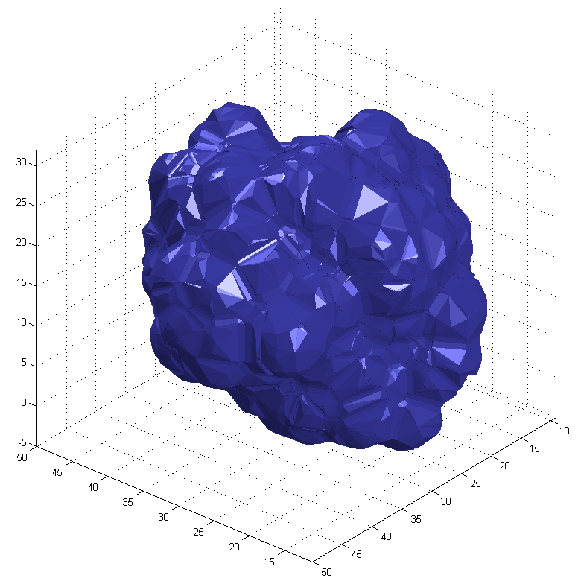
Hydration shell

Slide 21
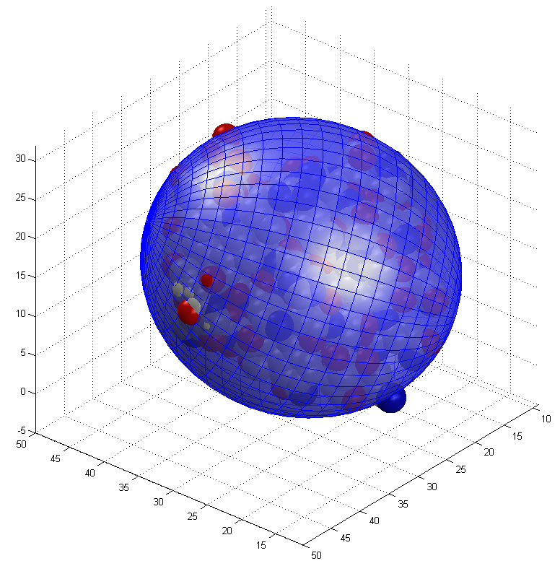
Hydration shell
Equivalent ellipsoid is approximately twice bigger

Slide 22
Complexity of the algorithms
N_{at}
ELM
2
HYDRONMR
N_{at}
ELM : HYDRONMR
1 : 500

Slide 23
Comparison with the experimental data

Slide 24
ELM Algorithm
Build equivalent ellipsoid with PCA
Evaluate diffusion tensor components with Perrin’s Equations
Perrin J. Phys. Radium (1934, 1936)

Slide 25
Fast and accurate ELM algorithm, which is able to provide closed-form derivatives of the energy function associated with the overall shape restraints, can be used in Molecular Dynamics and for gradient minimization in protein structure determination routines.

Slide 26
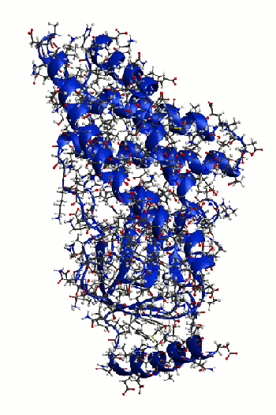
Refinement of a protein structure with Xplor-NIH
using overall shape restraints from diffusion tensor
N terminal domain from Enzyme I (EIN)
Standard Xplor-NIH simulated annealing protocol started from 3000K down to 25 K
With 12.5 K steps
Experimental restraints:
distance restraints derived from NOE
and
Components of Rotation Diffusion Tensor
10 lowest energy structures: Blue with diffusion tensor restraints
Green without diffusion tensor restraints

Slide 27
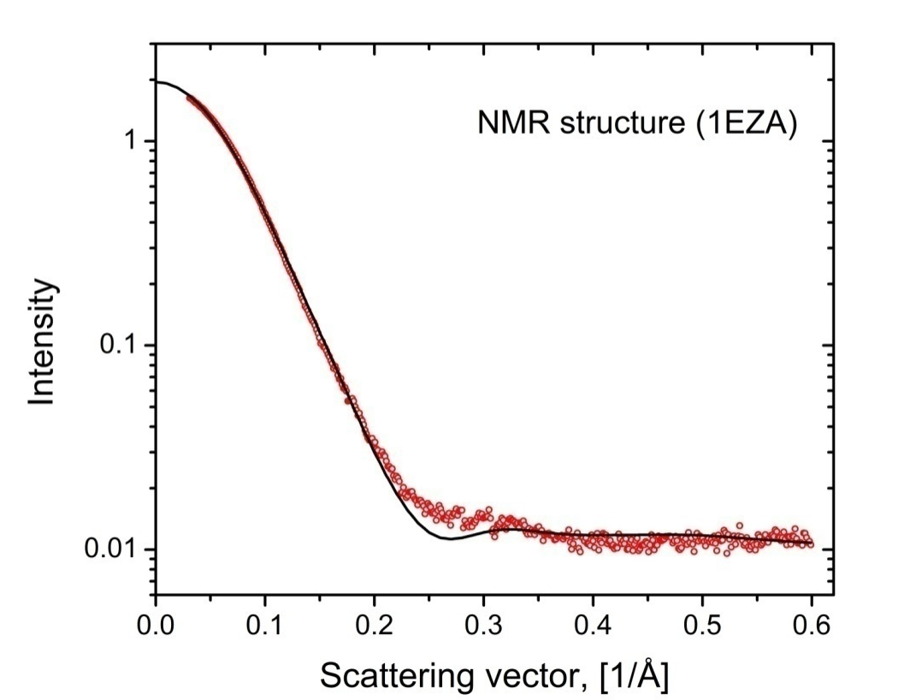
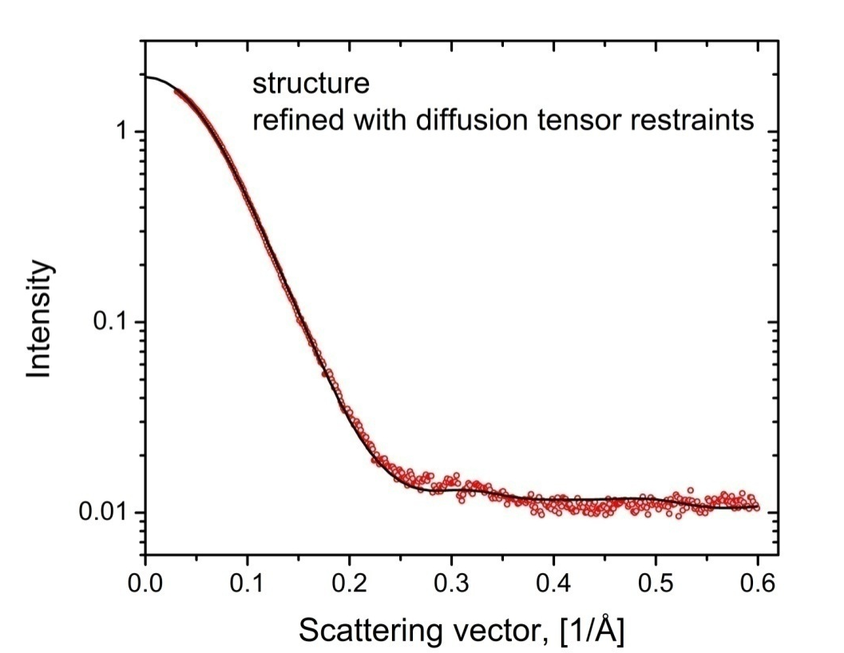
Validation with SAXS data
χ for comparison with SAXS data
2
1EZA (NMR) 2.03
1ZYM (X-ray) 1.38
Refined without diffusion tensor restraints 1.58
Refined with diffusion tensor restraints 1.37

Slide 28
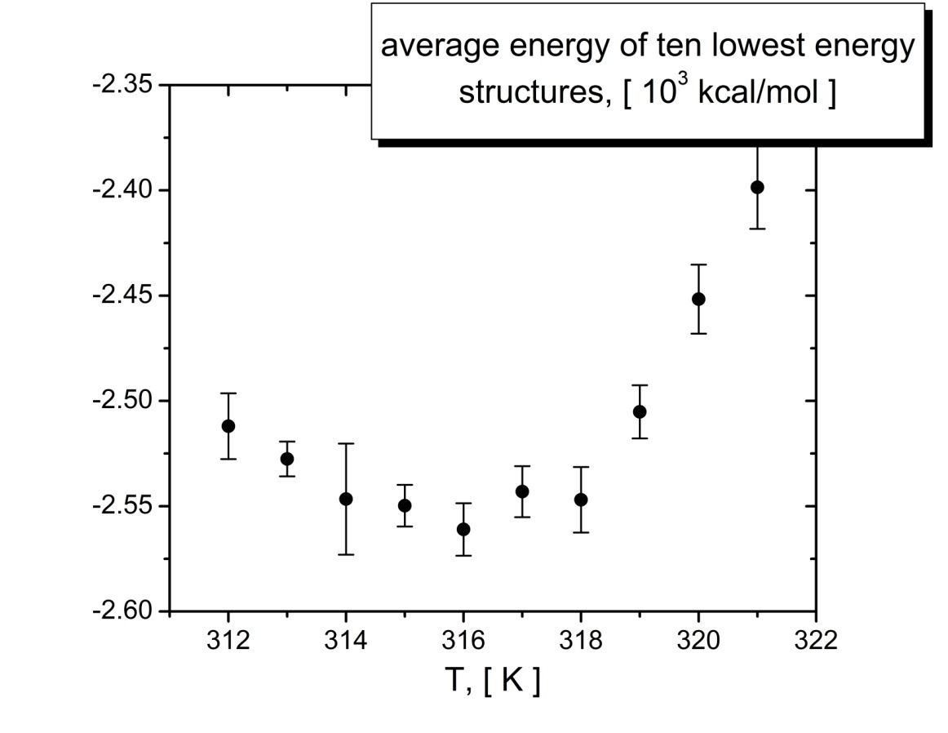
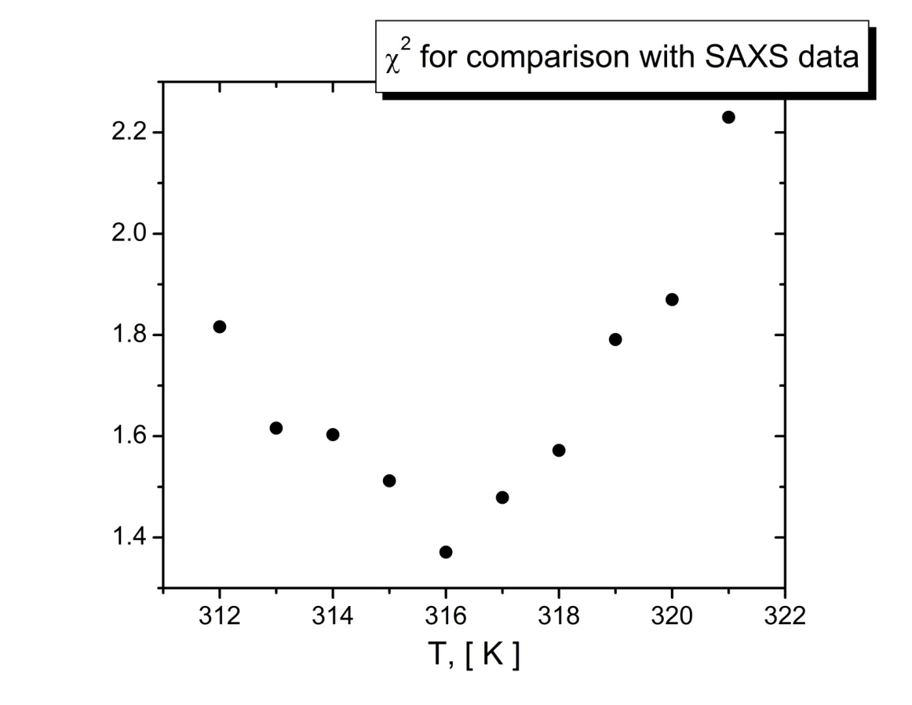
Effect of temperature settings for diffusion tensor term
Experimental temperature: 313 K
Temperature of the minimum: 316 K
Uncertainties in
thickness of hydration layer, sample temperature, and sample viscosity

Slide 29
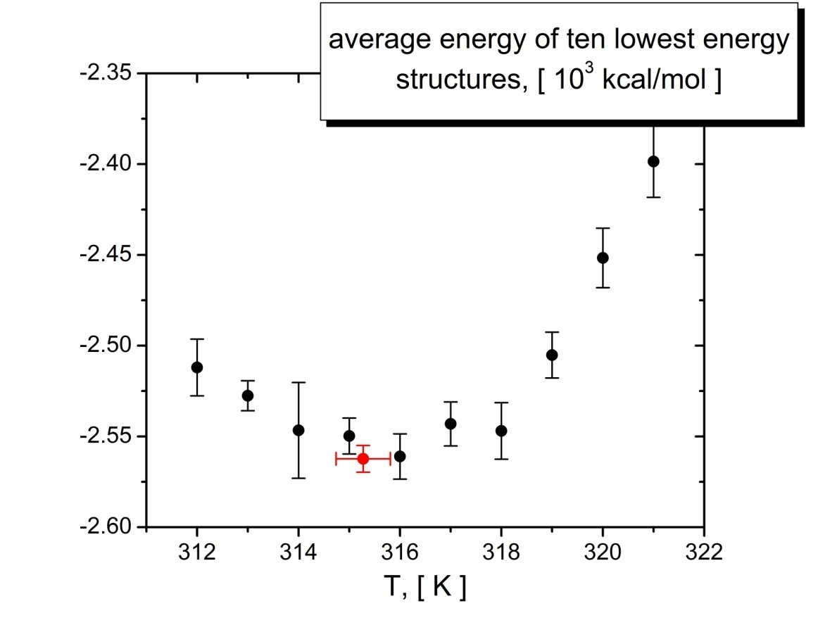
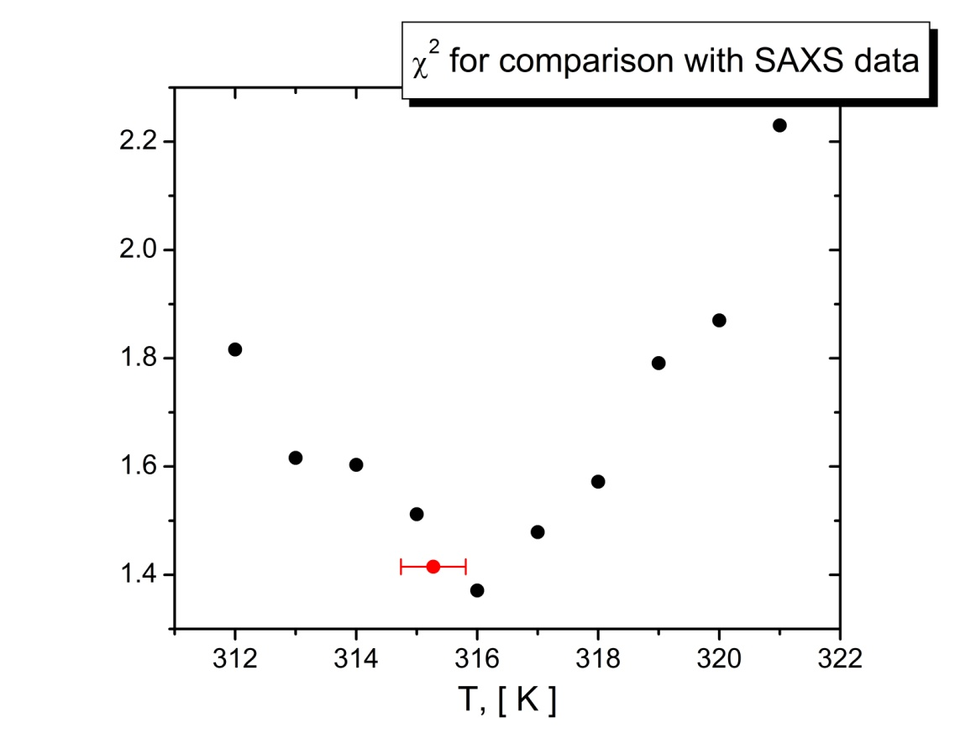
Effect of temperature settings for diffusion tensor term
Experimental temperature: 313 K Optimized Temperature: 315.3 ± 0.5
Temperature of the minimum: 316 K
Uncertainties in
thickness of hydration layer, sample temperature, and sample viscosity

Slide 30
Assembling structures of multi domain proteins
using the overall shape restraints provided by the diffusion tensor
Global restraints on Overall shape

Slide 31
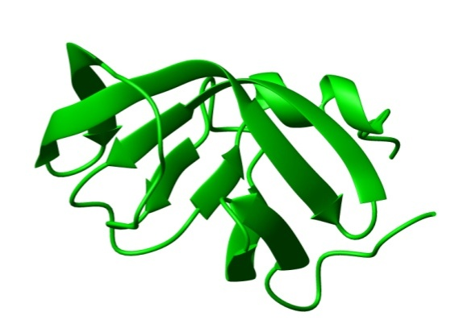
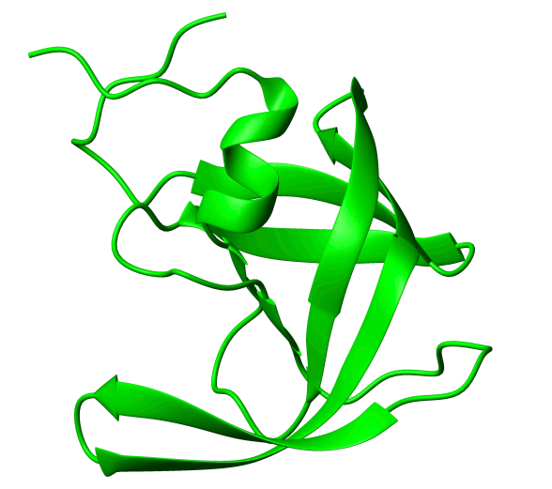
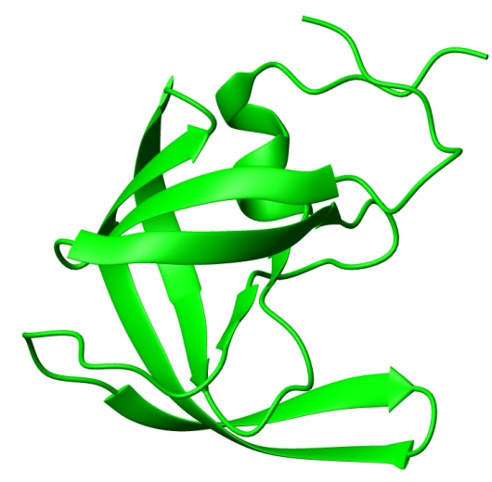
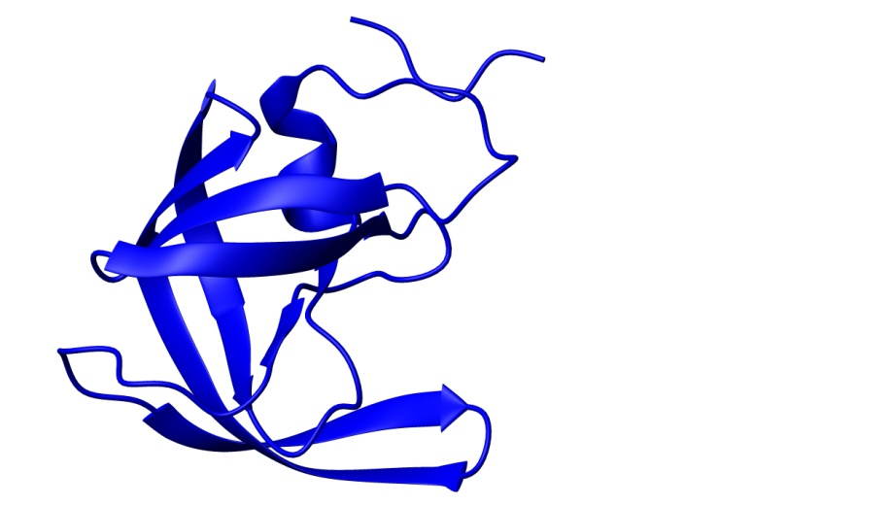
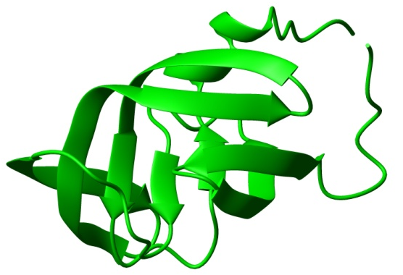
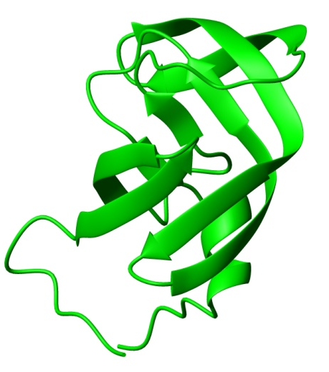
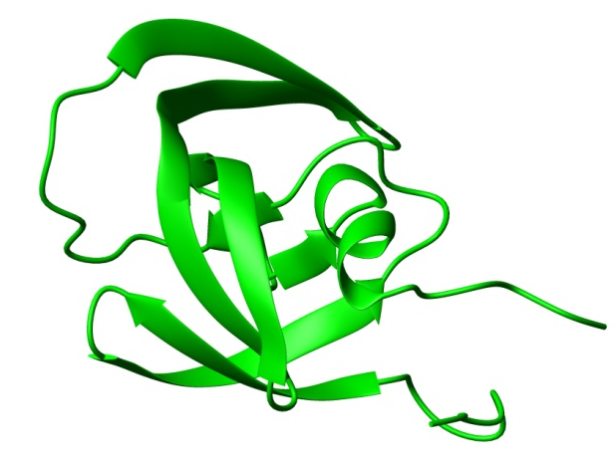
Assembling structure of a symmetric protein homo dimer
HIV -1 protease

Slide 32
Assembling structure of a symmetric protein homo dimer
Generic docking protocol
Part I:
Rigid body dynamics
for raw domain positioning.
Part II:
Simulated annealing
with flexible side chains
for final adjustment.

Slide 33
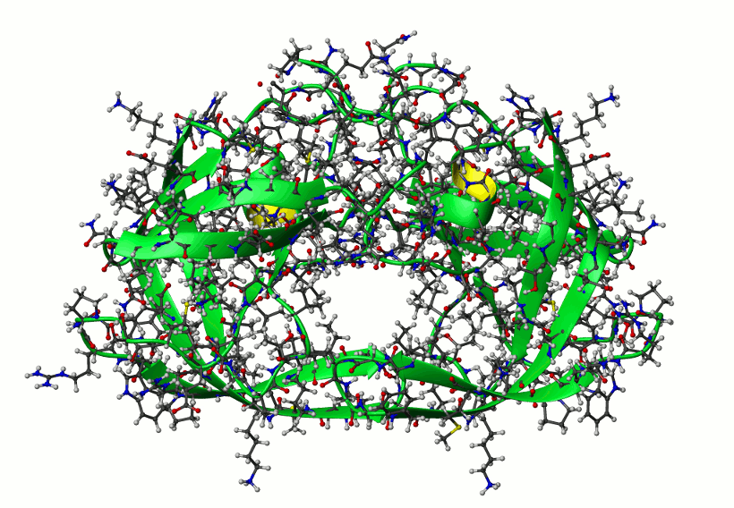
Assembling structure of a symmetric protein homo dimer
HIV -1 protease
Randomization of domain positions
and Rigid body dynamics repeated 10 times;
then the lowest energy structure submitted to final simulated annealing part of the protocol
512 structures calculated.
The only experimental restrains are
Components of Rotation Diffusion Tensor
10 lowest energy structures

Slide 34
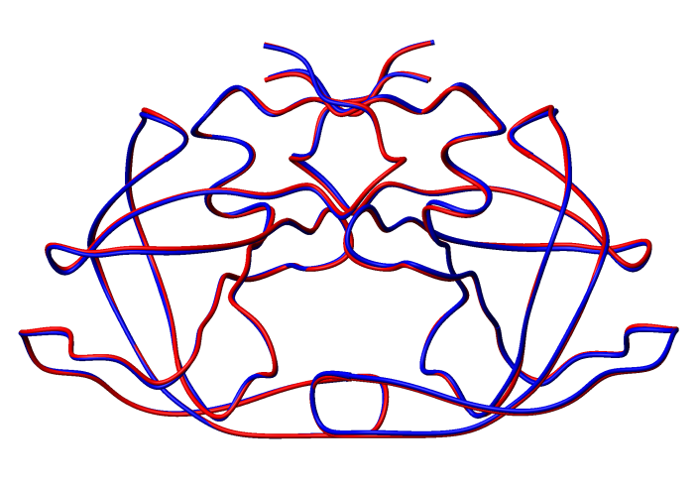
Assembling structure of a symmetric protein homo dimer
HIV -1 protease
10 lowest energy structures
Averaged over 10 lowest energy structures (blue) versus reference (red)
Cα RMSD 0.35 ±0.09 [Å]

Slide 35
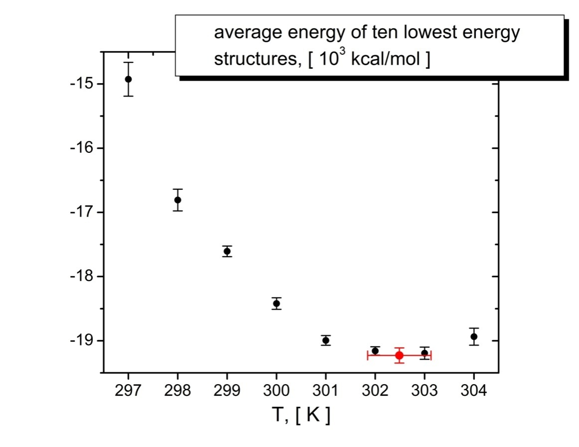
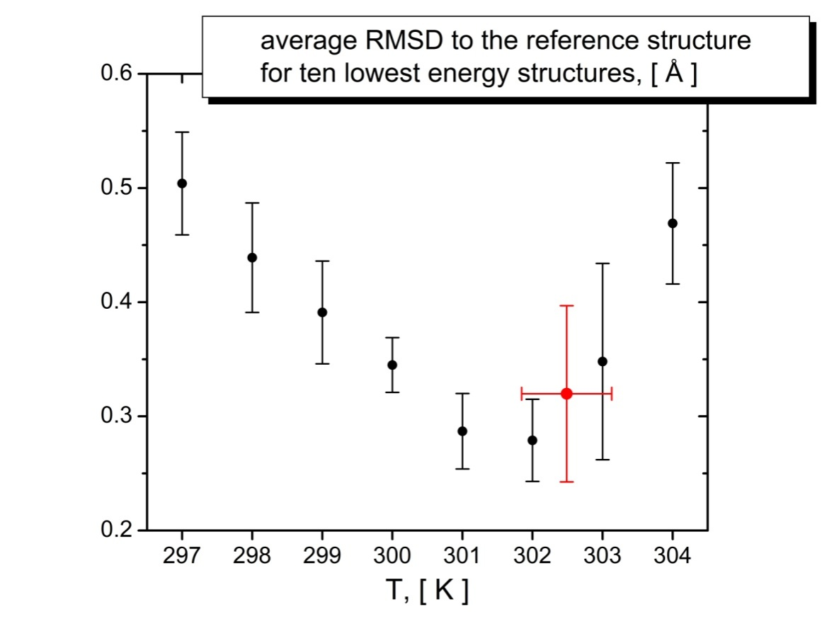
Assembling structure of a symmetric protein homo dimer
Experimental temperature: 300 K Optimized Temperature: 302.5 ± 0.6
Temperature of the minimum: 303 K

Slide 36
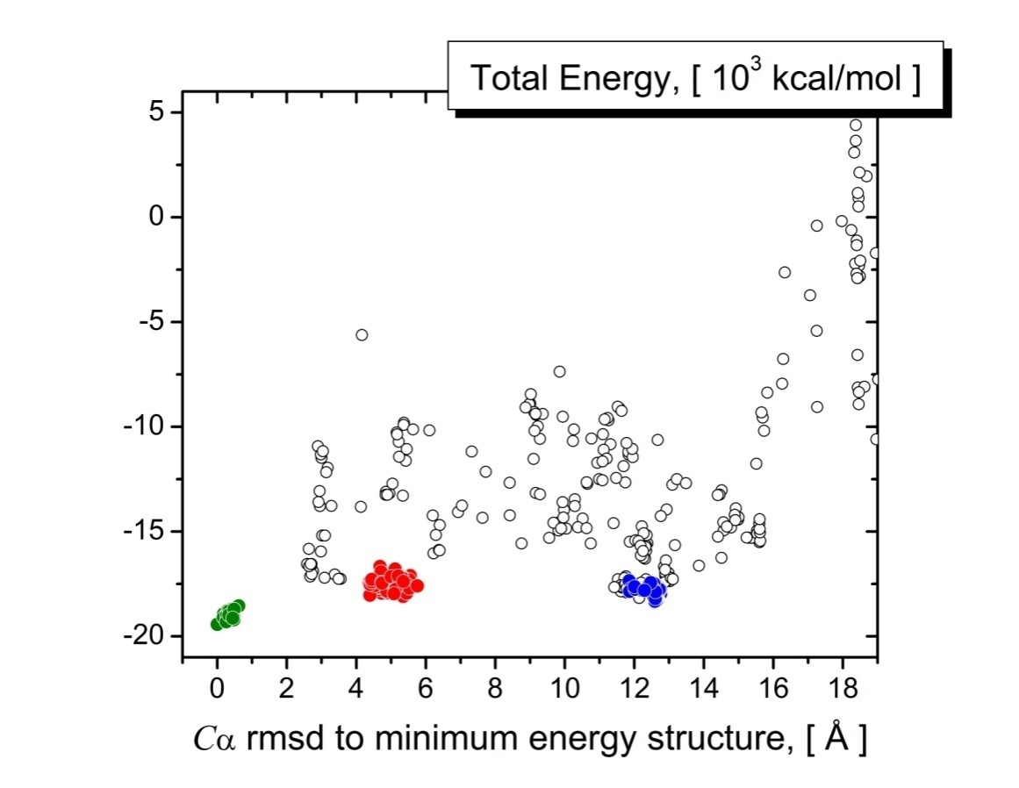
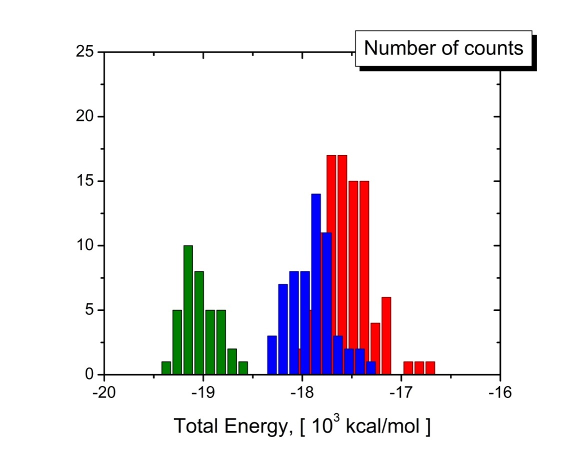
Assembling structure of a symmetric protein homo dimer
HIV -1 protease
13 % of all structures
Diffusion tensor shape restraints have they own right to define domain assembly in protein complexes

Slide 37
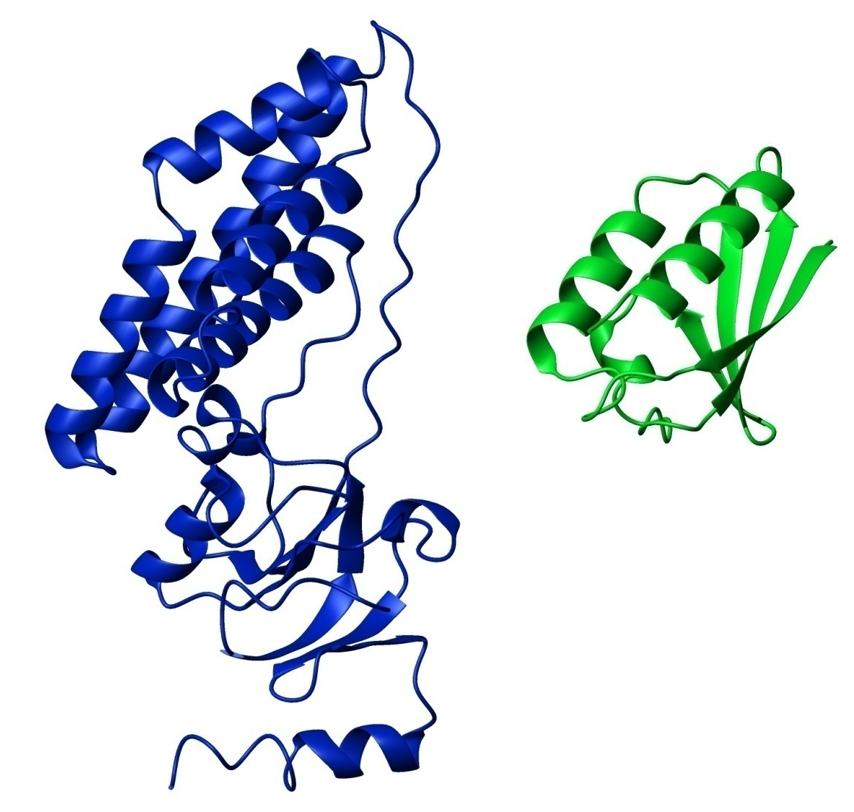
Application to an asymmetric complex
EIN – HPr complex

Slide 38

Application to an asymmetric complex
EIN – HPr complex

Slide 39
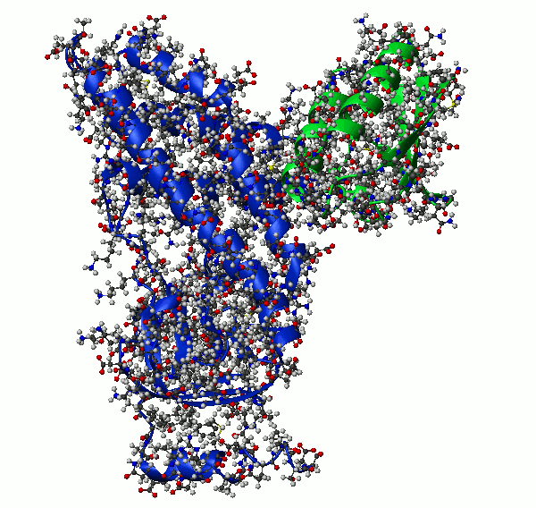
Application to an asymmetric complex
EIN – HPr complex
10 lowest energy structures

Slide 40
Application to an asymmetric complex
EIN – HPr complex
10 lowest energy structures

Slide 41
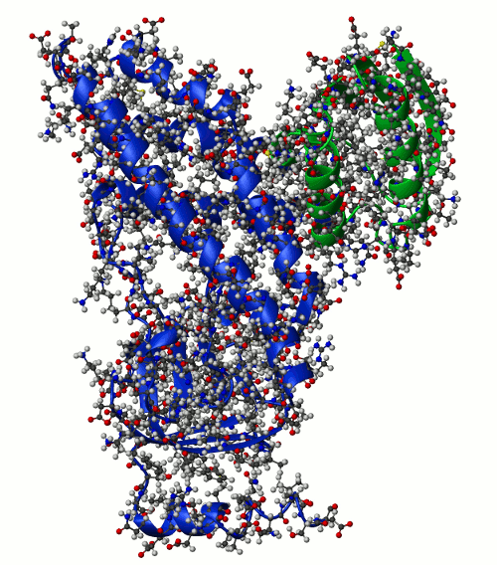
Application to an asymmetric complex
EIN – HPr complex
10 lowest energy structures

Slide 42
Application to an asymmetric complex
EIN – HPr complex
Randomization of domain positions
and Rigid body dynamics repeated 10 times; then the lowest energy structure submitted to final simulated annealing part of the protocol
512 structures calculated.
Experimental restrains were
Components of Rotation Diffusion Tensor
and
Highly ambiguous distance restraints
from chemical shift perturbation mapping
10 lowest energy structures

Slide 43
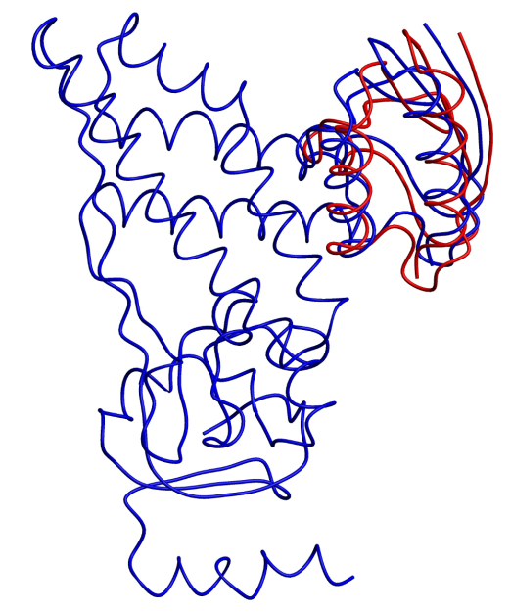
Application to an asymmetric complex
EIN – HPr complex
10 lowest energy structures
Cα RMSD 1.20 ±0.03 [Å]

Slide 44
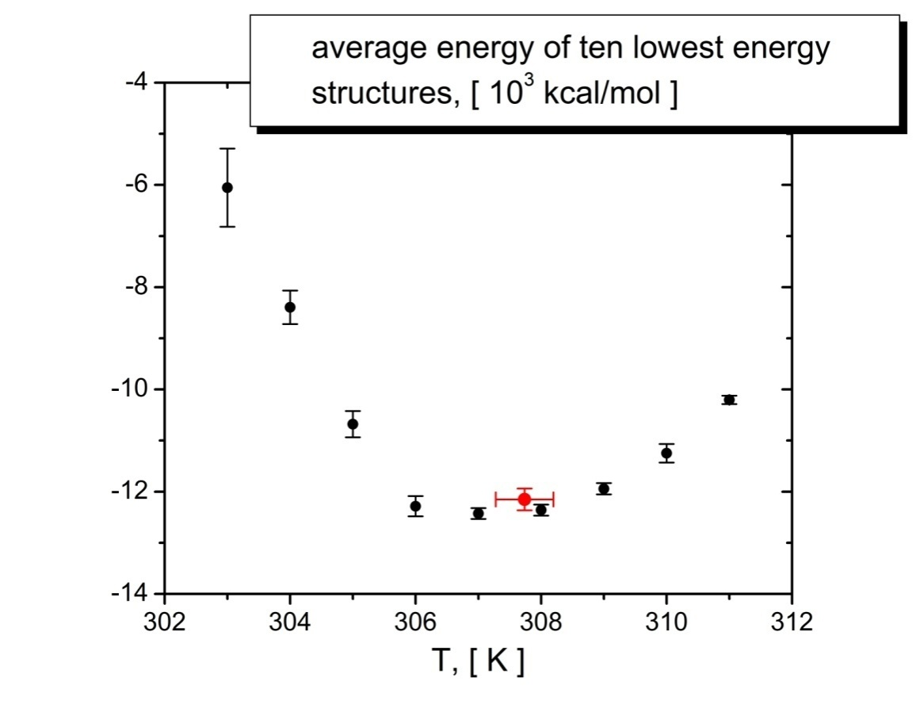
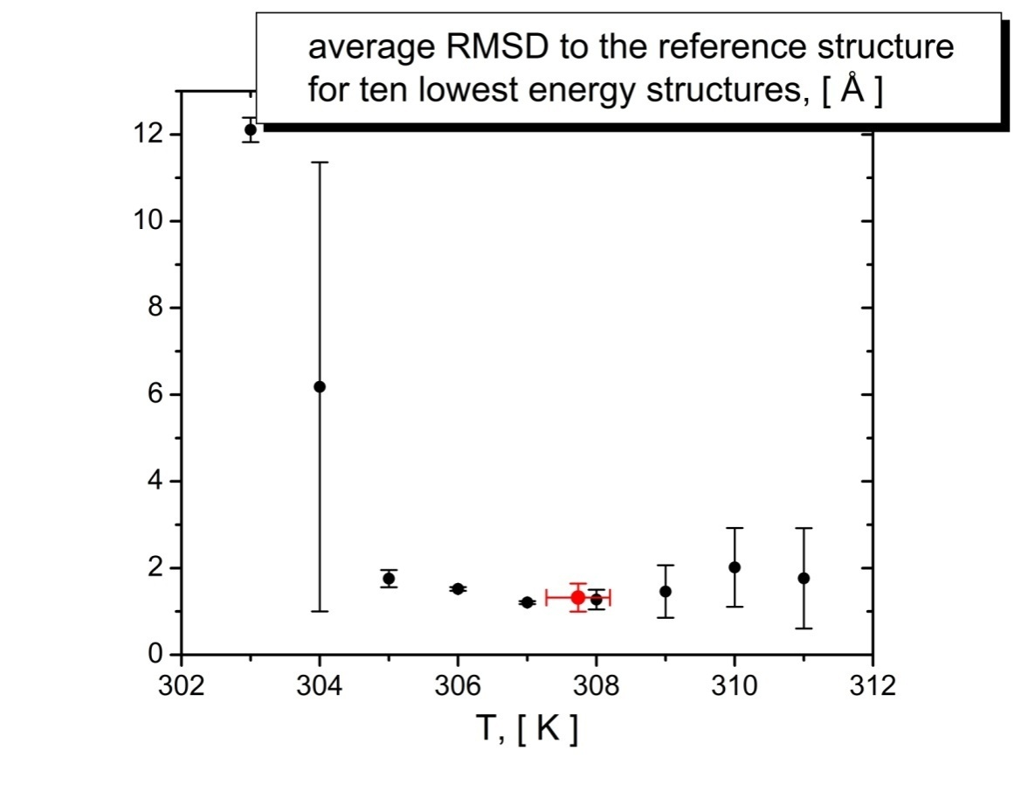
Application to an asymmetric complex
Experimental temperature: 313 K Optimized Temperature: 307.7 ± 0.5
Temperature of the minimum: 307 K

Slide 45
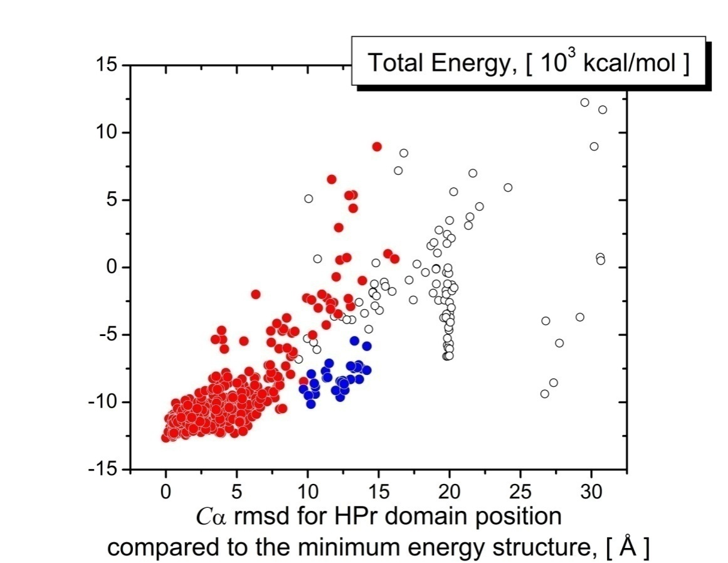
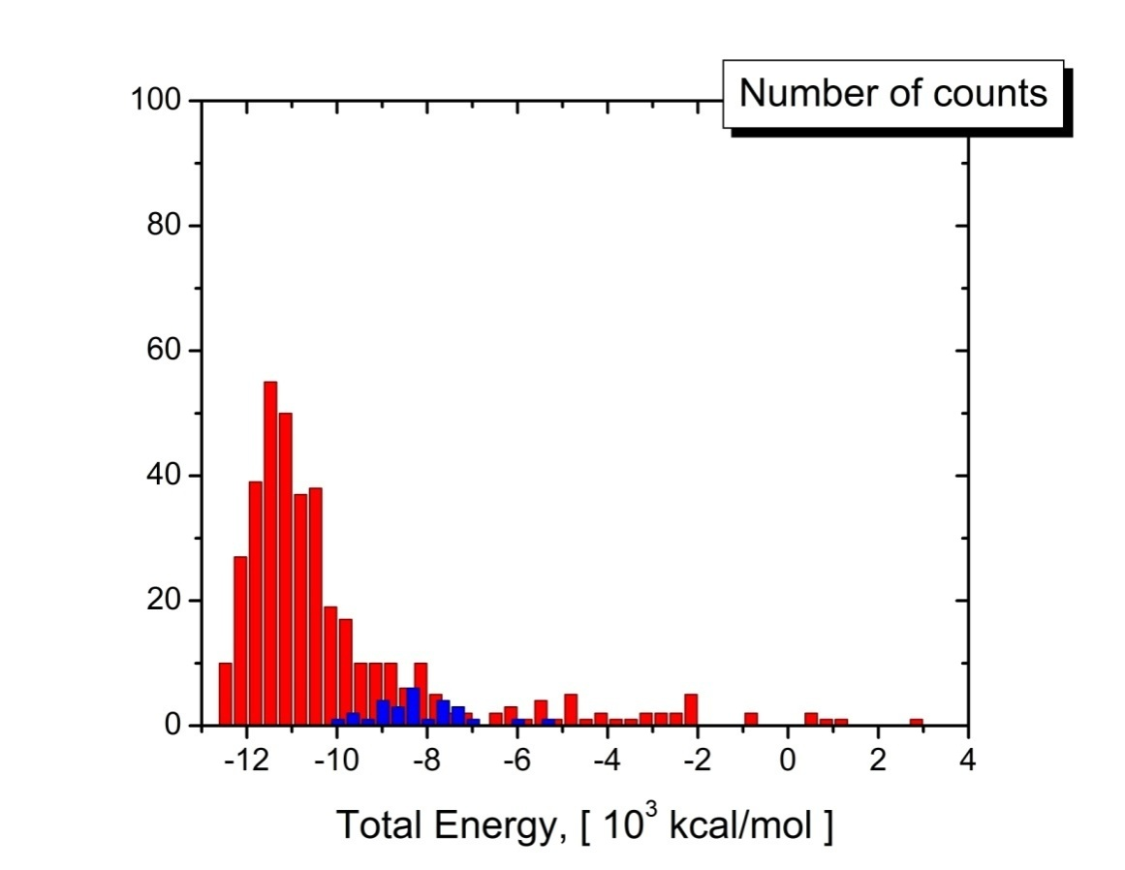
Application to an asymmetric complex
EIN – HPr complex
75 % in the largest cluster of solutions (red)

Slide 46
CONCLUSIONS
Accuracy of the structures obtained using shape restraints derived from protein rotation tensor is comparable to the accuracy of standard structure determination protocols.
When refining structures of globular proteins, these restraints, in combination with other information, could help to solve the problem of poor packing density of NMR protein structures.
When assembling protein complexes, the relaxation data even for one domain of the complex are enough to drive accurate domain assembly.
In some cases these restraints can be the only experimental information necessary to obtain correct domain assembly.

Slide 47
Immediate
Future directions
Orientation information form Diffusion Tensor

Slide 48
Future directions
Structural information from residue specific relaxation NMR rates
Experimentally
Measured relaxation rates
Correlation function
Spectral density
R₁
C(t)
J(ω)
R₂
Rotation of a protein as a whole
Protein Domain Mobility
Protein structure
Local mobility

Slide 49
Future directions
Structural information from residue specific relaxation NMR rates
R₂ /R₁
Independent of the local mobility
Rotation of a protein as a whole
Protein structure
Favro, Phys. Rev. 1960
Woessner, J. Chem. Phys. 1962

Slide 50
Future directions
Structural information from residue specific relaxation NMR rates
R₁
R₂
and
separate
Rotation of a protein as a whole
Protein structure
Local mobility
Requires ensemble refinement
to evaluate order parameters
S²
Favro, Phys. Rev. 1960
Woessner, J. Chem. Phys. 1962
Lipari & Szabo
J. Am. Chem. Soc. 1982

Slide 51
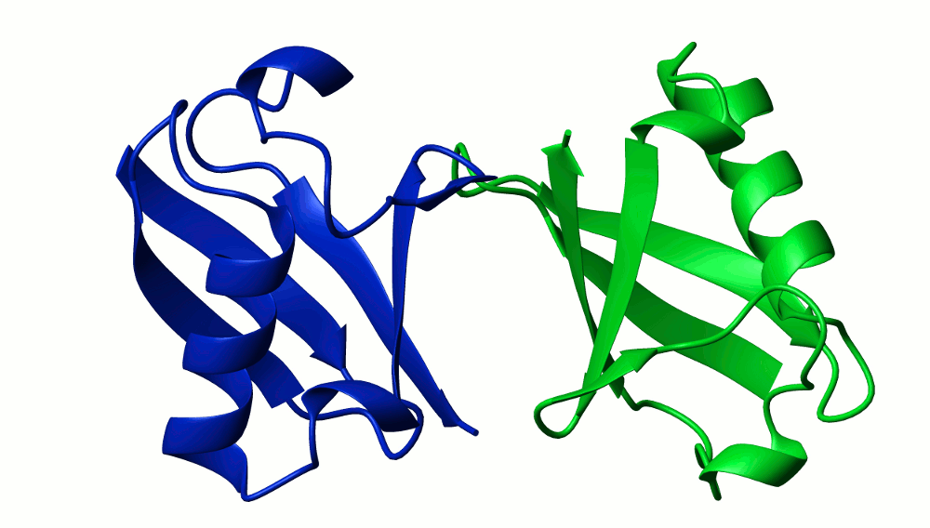
Far
Future directions
Structural information from residue specific relaxation NMR rates
Protein Domain Mobility

Slide 52
ACKNOWLEDGMENTS
Co-authors of the paper: Jeong-Yong Suh,
Alexander Grishaev,
G. Marius Clore,
Charles D. Schwieters
For the help Daniel Garrett
with the NMR data on EIN
For the help John Kuszewski
with Xplor-NIH code
For funding National Research Council

Slide 53
Correlation times for 841 protein structures
Hydration shell effect
70
[
τ
τ
Corr
2
PCA
(0.0),
(3.2) ] = 0.994
60
H
50
40
(0.0) , [ns]
PCA
30
τ
2
20
10
10
20
30
40
50
60
70
τ
(3.2) , [ns]
H
Power law
q ~ 0.923
Fractal surface dimension
~2.2 ÷ 2.3

Slide 54
Correlations for diffusion tensor components

Slide 55
Correlations of diffusion tensors orientations

