Slide 1

Lognormal Pattern
of Exon size distributions
in Eukaryotic genomes
Yaroslav Ryabov

Slide 2
Outline
Global and local approaches in analysis of genetic information
Vocabulary of contemporary genetics: Exons and Introns
What we can learn from exon size distributions? Lognormal pattern and two clases of exons
How we can model exon size distributions of real genomes?
What could be the biological reason for observed pattern of exons size distributions?
Conclusions

Slide 3
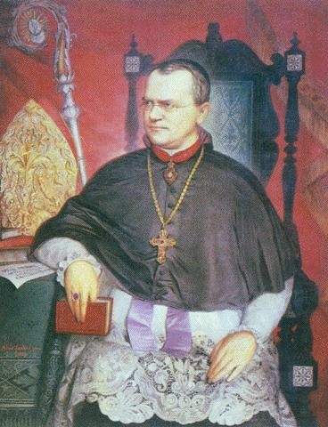
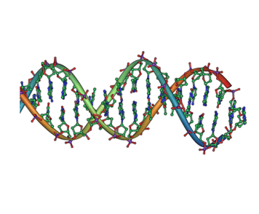
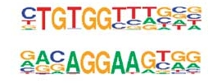
Analyzing Genetic Information
Global approach
analyzing properties
of entire genome
Recombination of inherited properties
Frequency of mutations
Size of genome etc.
Georg Johann Mendel
1866
Local approach
analyzing details of
nucleotide sequence
Watson and Crick
1953
Marshall Nirenberg
1968
Basic Local
Alignment Search Tool
1990

Slide 4
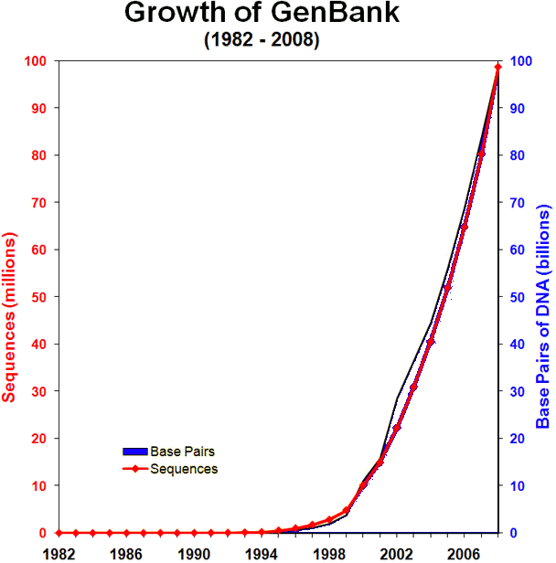

Analyzing Genetic Information
in Post-Genomic Era
More than 60 animal genomes with complete annotations

Slide 5
Analyzing Genetic Information
in Post-Genomic Era
More than 60 animal genomes with complete annotations
Back to Global Approach ?

Slide 6
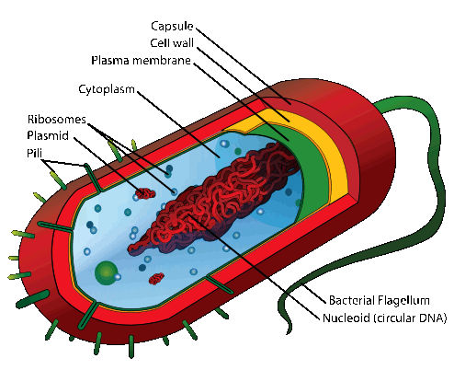
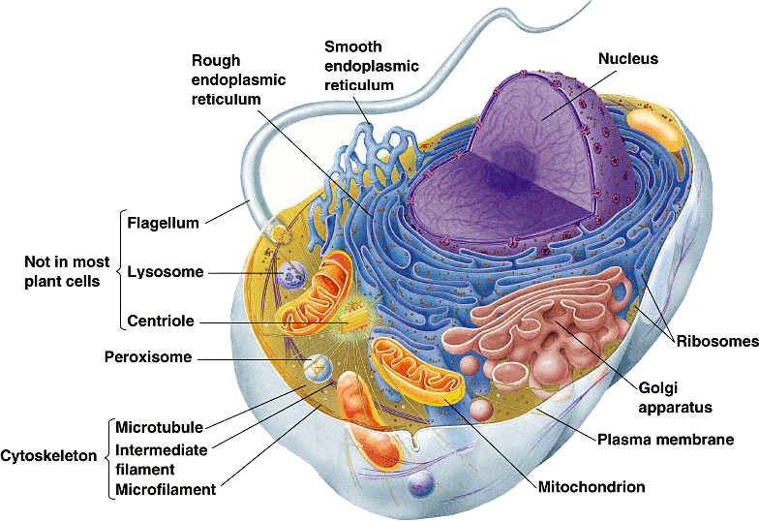
Prokaryote and Eukaryote
pro + karyon
before + nucleos
eu + karyon
good + nucleos

Slide 7
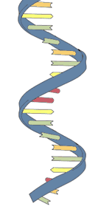
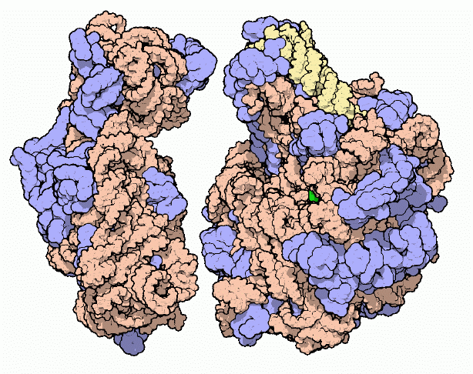
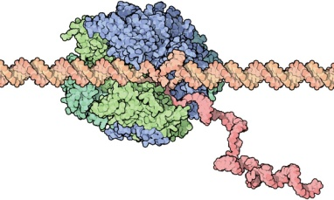
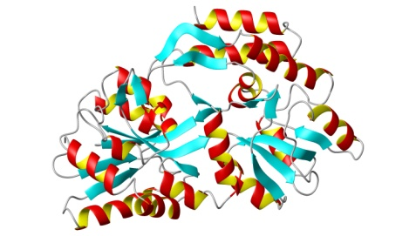
Gene expression
mRNA
Transcription
with RNA polymerase
Translation
with ribosome
DNA
Protein

Slide 8
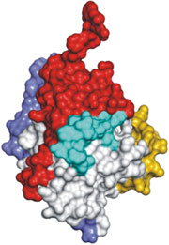
Splicing in Eukaryotes
Transcription
with RNA polymerase
mRNA
DNA
Splicing
Exons
Introns

Slide 9
Prokaryote vs Eukaryote
Most of DNA code is used to produce some cellular product
Substantial fraction “silent” DNA regions
Exons
Introns
Short genomes: ~ 1 000
exons
Long genomes: ~ 100 000 exons
Long exons: ~ 1 000
base pairs
Short exons: ~ 100
base pairs

Slide 10
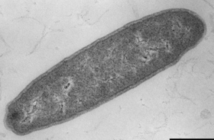

Prokaryote vs Eukaryote
Exon size distributions
Flavobacteria Bacterium
Homo Sapiens

Slide 11
What we can learn from exon
size distributions ?
Flavobacteria Bacterium
Homo Sapiens
2 592 exons
1 075 b.p. mean exon size
299 298 exons
267 b.p. mean exon size

Slide 12
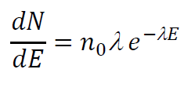
Poisson Process
Assumption:
Probability to split DNA at any location and any time is Constant
λ = Const frequency of splitting
Consequence:
The lengths of intervals between
splitting points obey
Exponential distribution

Slide 13
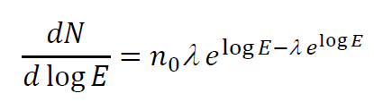
Poisson Process
Assumption:
Probability to split DNA at any location and any time is Constant
λ = Const frequency of splitting
Consequence:
The lengths of intervals between
splitting points obey
Exponential distribution
or in logarithm scale

Slide 14

Poisson Process Kolmogoroff Process
Exponential distribution
Lognormal distribution

Slide 15
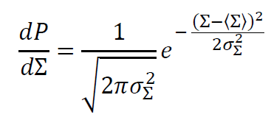

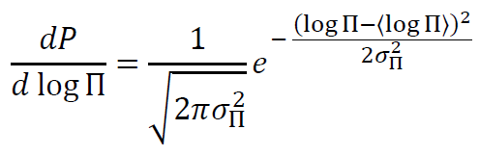


Lognormal distribution
is a consequence of Central Limit Theorem
Sum
of random variables
Normal distribution
Product
of random variables
Lognormal distribution

Slide 16


Kolmogoroff process (1941)

Slide 17

Kolmogoroff process (1941)

Slide 18

Kolmogoroff process (1941)
Assumption:
Probability to split any exon is Independent of exon size

Slide 19

Kolmogoroff process (1941)
Assumption:
Probability to split any exon is Independent of exon size

Slide 20

Kolmogoroff process (1941)
Assumption:
Probability to split any exon is Independent of exon size

Slide 21

Kolmogoroff process (1941)
Assumption:
Probability to split any exon is Independent of exon size

Slide 22

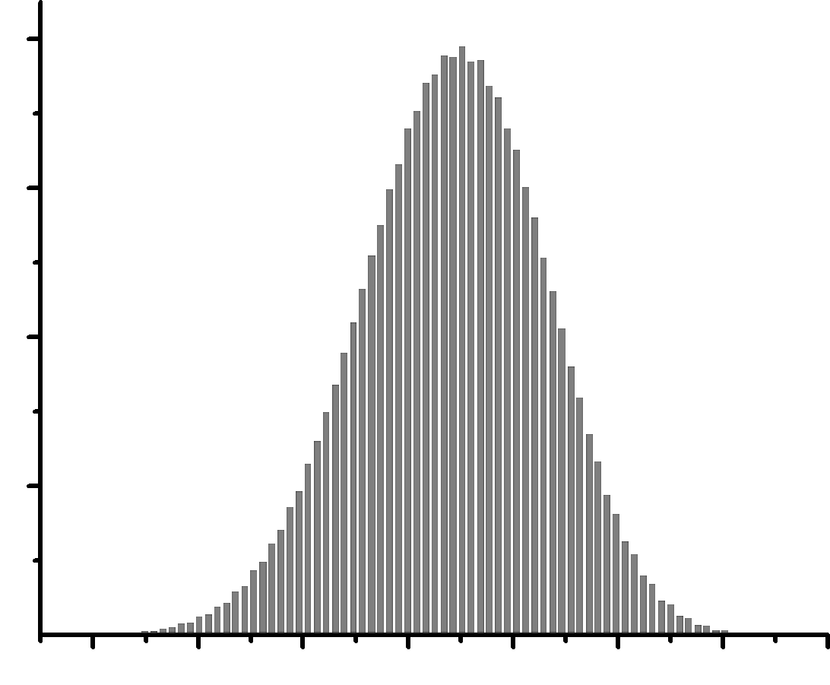
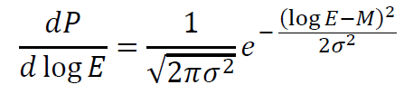


Kolmogoroff process (1941)
Assumption:
Probability to split any exon is Independent of exon size
Consequence:
The lengths of exons obey
Lognormal distribution
M
2σ
Number of Counts
Log (Exon Size)

Slide 23


Real Genomes: Two Lognormal Peaks

Slide 24










Slide 25
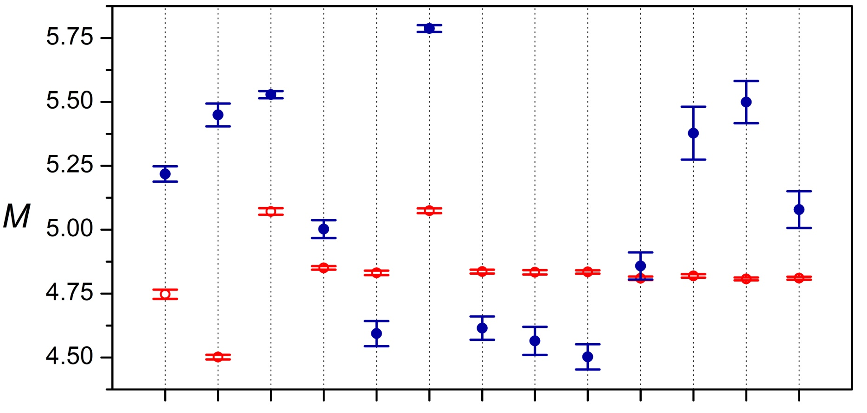

Parameters of Two Lognormal peaks model: M location of peak maximum
Ryabov & Gribskov, Nucleic Acids Research, 36, 2756-2763 (2008)

Slide 26
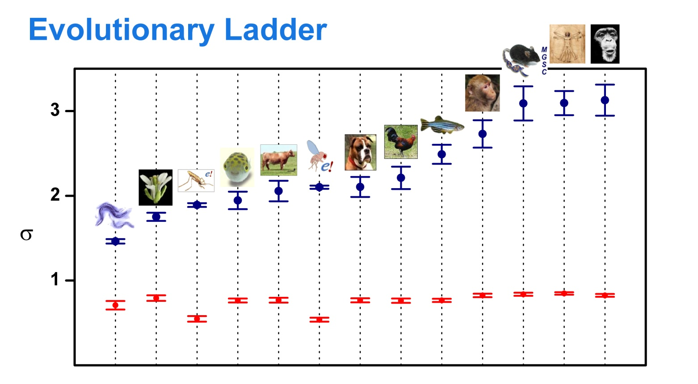
Parameters of Two Lognormal peaks model: σ peak width
Ryabov & Gribskov, Nucleic Acids Research, 36, 2756-2763 (2008)

Slide 27
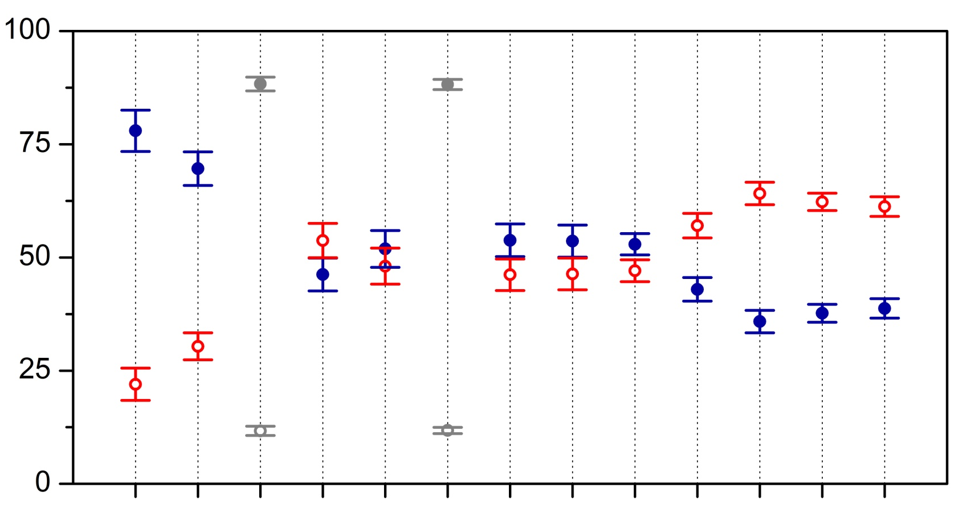
Parameters of Two Lognormal peaks model: peak area Narrow and Wide, %
Ryabov & Gribskov, Nucleic Acids Research, 36, 2756-2763 (2008)

Slide 28
Summary of Observed Facts
Exon lengths distributions of studied eukaryotic genomes can be fitted by Two Lognormal Distributions
Parameters of those two peaks follow two distinctive patterns: changes of peak width and relative peak area correlate with complexity of species.
This may indicate presence of two different classes of exons with different evolutionary histories

Slide 29
How we can model exon size distributions of real genomes ?
Growth of total genome length
Duplications in genome code
Merging exons together (intron loss)
Exon loss

Slide 30


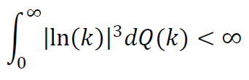
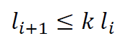
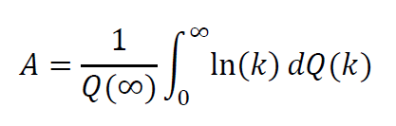
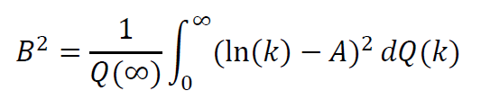
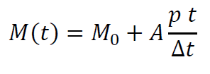
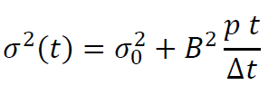
Parameters of Kolmogoroff Process
as model parameters for elementary “exon modification” event
If
any exon of length has probability to be modified during time interval
and
average number of
exons with sizes
with
Then the process converges to a lognormal distribution with
peak position
peak width

Slide 31




Parameters of Q(k) function
distribution
Exons splitting (decreasing Exon length)
Exons duplicating
Increasing Exon length

Slide 32
Modeling exon size distributions in real genomes
Initial exon size distribution
A mockup of a bacterial genome with 500 exons
Having 1000 bp mean exons length

Slide 33
Modeling exon size distributions in real genomes
15 000 time steps for p=0.001

Slide 34
Modeling exon size distributions in real genomes
15 000 time steps for p=0.001

Slide 35
Modeling exon size distributions in real genomes
15 000 time steps for p=0.001

Slide 36
Modeling exon size distributions in real genomes
50 000 time steps for p=0.001

Slide 37
Modeling exon size distributions in real genomes
50 000 time steps for p=0.001

Slide 38
Modeling exon size distributions in real genomes
50 000 time steps for p=0.001

Slide 39
What cloud be the biological reason for two exons peaks?
Narrow peak
Number of Counts
Wide peak
Log (Exon Size)

Slide 40
What could be the biological reason for two exons peaks?
Narrow peak
Wide peak
Holds approximately
Constant position
Changes position
Has approximately
Constant width
Width increases with
increasing complexity
of and organism
Has greater relative
occupation for
Complex organisms
Has greater relative
occupation for
Simple organisms

Slide 41
Two ways of Gene Expression Regulation
mRNA
Alterative Splicing
Untranslated regions of mRNA
Introns
DNA
Protein

Slide 42
Two ways of Gene Expression Regulation
mRNA
Untranslated regions of mRNA
Introns
DNA
Protein

Slide 43
Conclusions
Analysis of global properties of eukaryotic genomes reveals two distinct peaks in statistical distribution of exon sizes
The observed peak could be fitted by a sum of two lognormal distributions which may imply that they originated by two different exon splitting pathways described in the general frameworks of Kolmogoroff splitting process
Two observed peaks of exons could be correlated with the phenomenon of alternative splicing and with exons contributing into untranslated regions of mRNA. This suggests that the observed separation of exons in two different classes may be originated from two different ways of protein expression regulation.

Slide 44
Acknowledgments
Michael Gribskov
Alexander Berezhkovskii

